Slide 1
Access Control, Authentication, and Public Key Infrastructure
Lesson 13
Public Key Infrastructure and Encryption

Slide 2
Public Key Infrastructure (PKI)
A framework that:
  Consists of programs, procedures, and security policies
  Employs public key cryptography and the X.509 standard (digital certificates) for secure communications
Is a hybrid system of symmetric and asymmetric key algorithms

Slide 3
Components of PKI
Certificate authority
Registration authority
Certificate server
Certificate repository
Certificate validation
Key Recovery Service
Time server
Signing server
Notes:
In cryptography, a certificate authority or certification authority (CA) is an entity that issues digital certificates. A digital certificate certifies the ownership of a public key by the named subject of the certificate.
A registration authority (RA) is an authority in a network that verifies user requests for a digital certificate and tells the certificate authority(CA) to issue it.

Slide 4
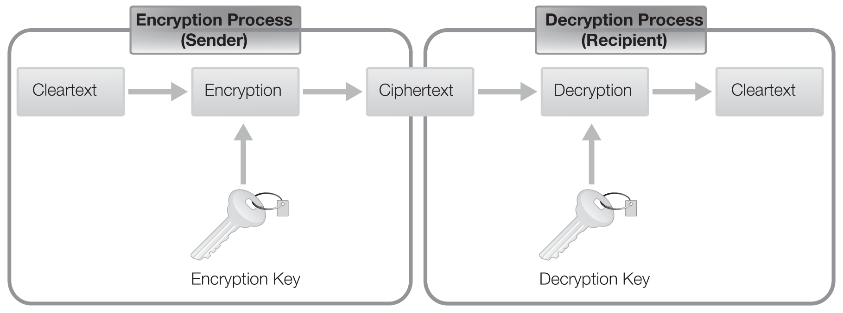
Encryption Process
Encryption is the process of applying an algorithm to cleartext (or plaintext) data, resulting in ciphertext

Slide 5
Encryption and Cryptography Terms
Cryptosystem
  A hardware or software system that provides encryption and decryption
  Is made up of the encryption algorithm, the keys, and the software and protocols
Secret piece of the cryptosystem is the key
Keyspace is the range of values that construct the key

Slide 6
Ensuring Integrity, Confidentiality, Authentication, and Nonrepudiation
Confidentiality
Integrity
Authentication
Nonrepudiation
Ensures that only the intended recipient can read a message
Ensures message recipient can be certain that message received was message sent
Allows someone to prove his or her identity to another
Ensures that a third party can verify that a message came from the purported sender

Slide 7
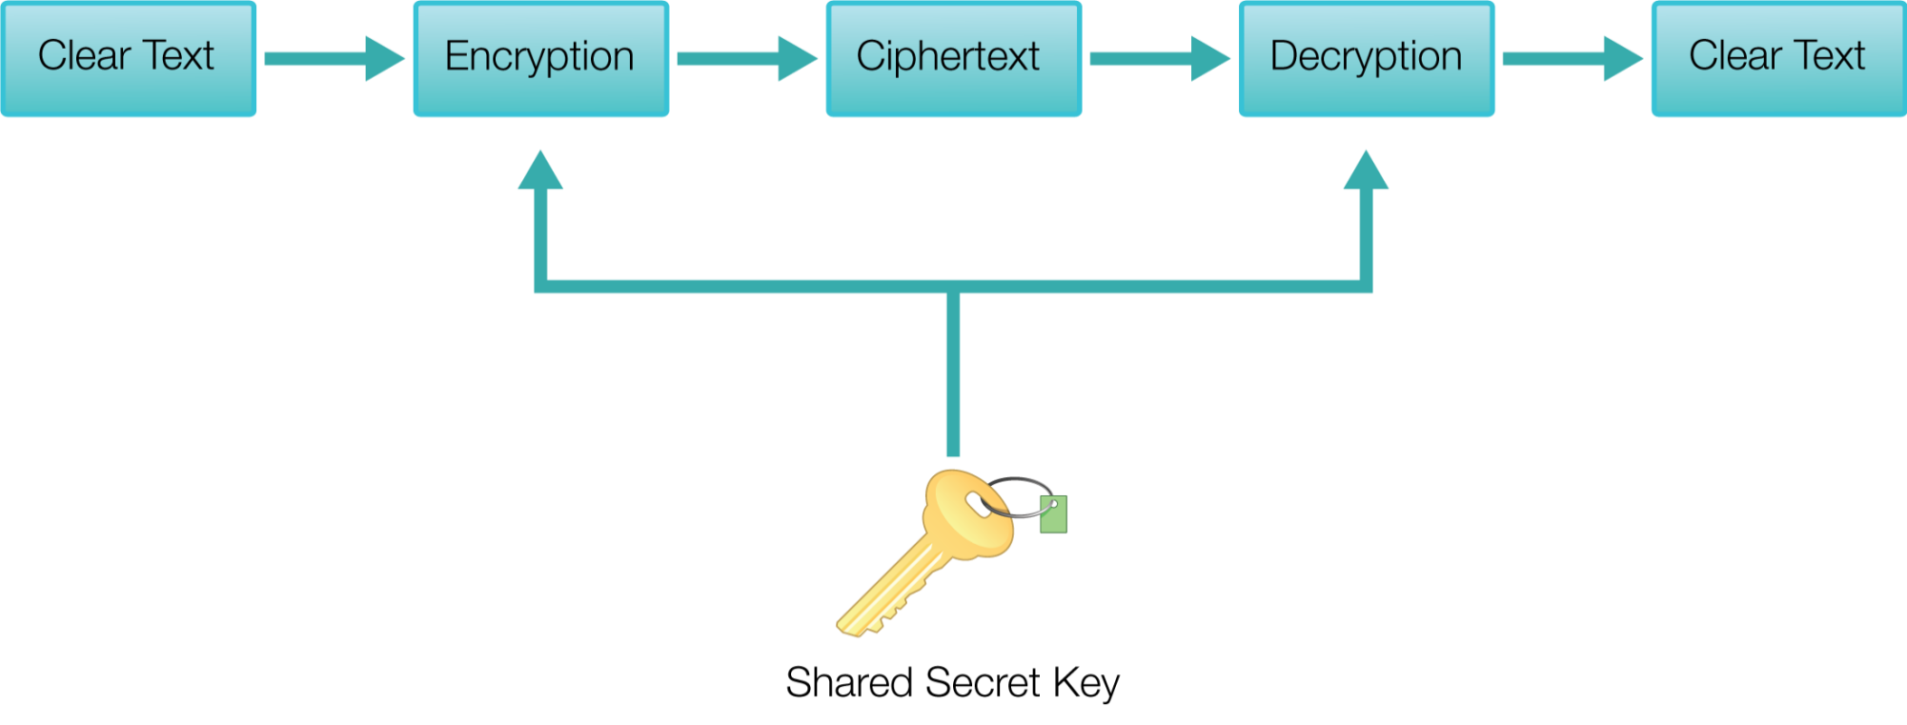
Symmetric Key Encryption Process

Slide 8
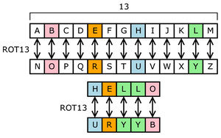
Shared Key Encryption
Data
Key
Encryption Process on System 1
System 2 applies shared key to decrypt encrypted data
Encryption Data sent to System 2
Original Data

Slide 9
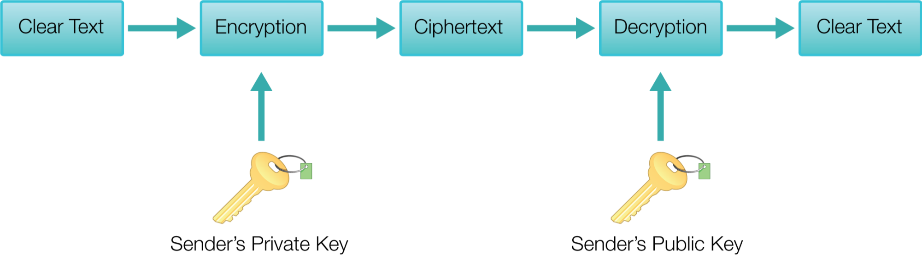
Asymmetric Key Encryption Process, Public Key

Slide 10
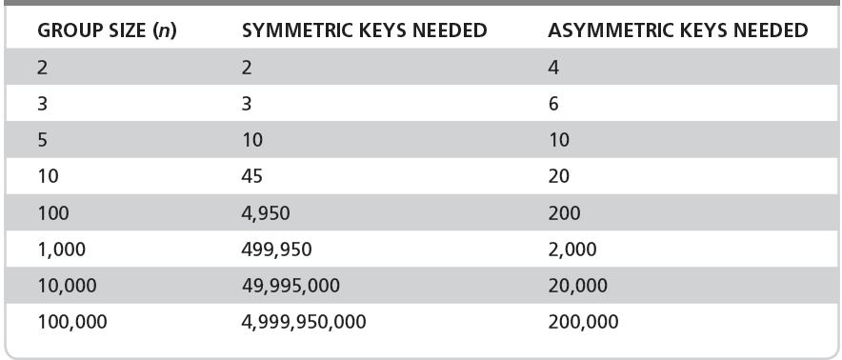
Number of Keys Needed
Notes:
N(N-1)/2
Asymmetric you just need a public and private for each N

Slide 11
Asymmetric Encryption Process Model
Joan’s Public Key on Internet (With Certificate Provider)
Request Joan’s public key to encrypt message to send over Internet
Message
Message
Joan receives message.
Decrypts message with her computer’s private key
Joan’s private key is only available to her.
Composes message
Encrypts w/Joan’s public key
Sends message
Joan’s public key is available to all Internet users

Slide 12
Business Requirements for Cryptography
Ensuring software and data integrity
Ensuring secure collaboration between entities inside and outside an organization
Ensuring secure cloud computing
Providing secure transactions with consumers

Slide 13
Digital Certificates
Are used by individuals and servers to provide unknown third parties with a known secure copy of their public encryption key
Certificate authority (CA) issues digital certificates after verifying the identity of the end user
Registration authority (RA) verifies the identity of an individual, initiates the certification process with a CA on behalf of the user, and performs certificate life-cycle management

Slide 14
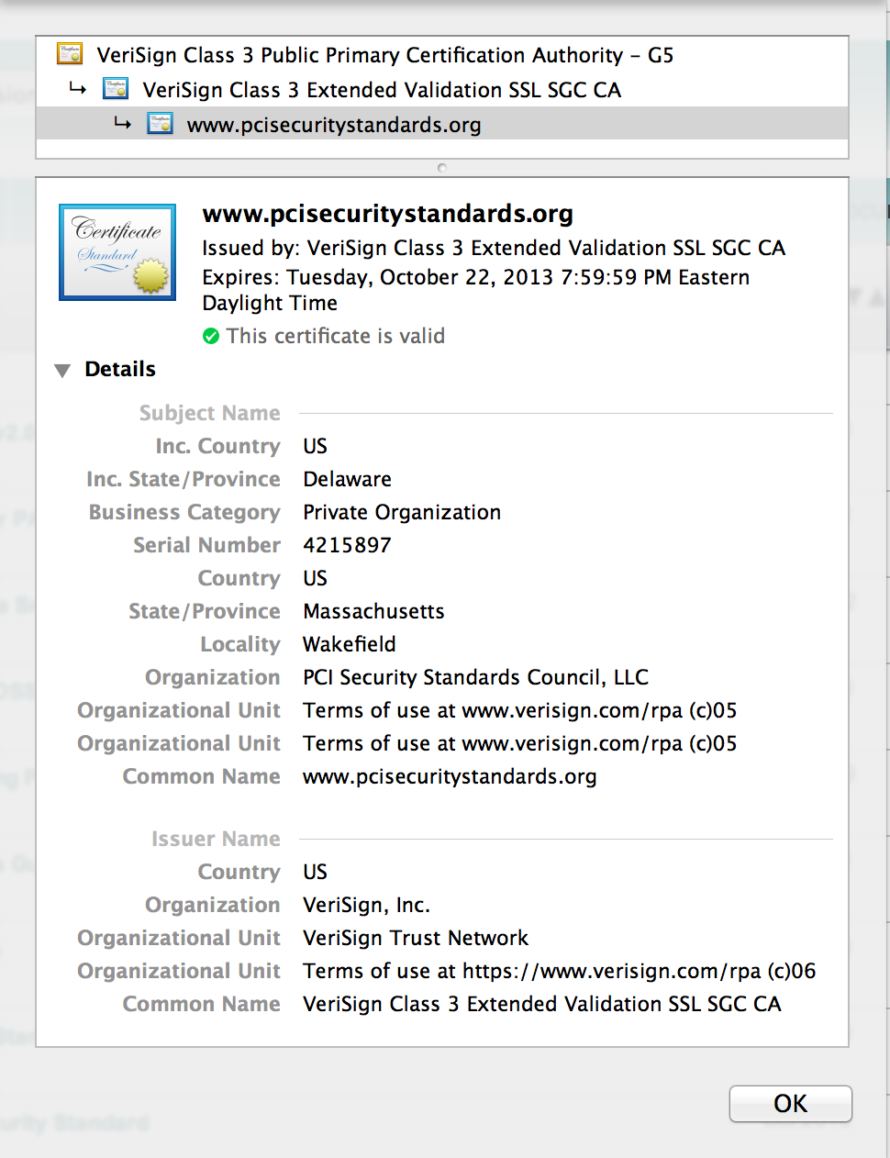
Digital Certificate Details

Slide 15
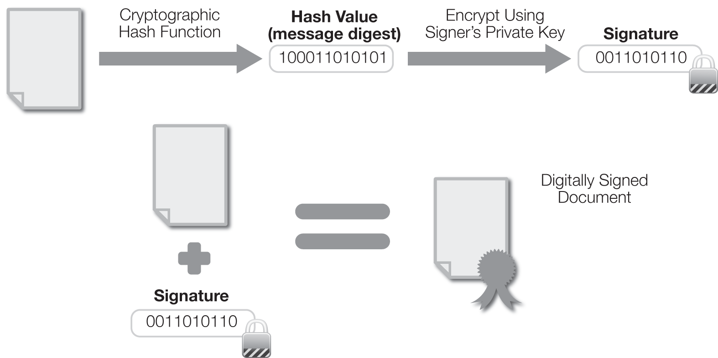
Digital Signature Process

Slide 16
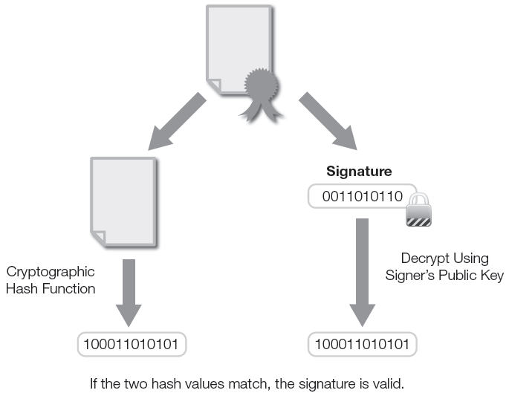
Digital Signature Verification

Slide 17
Estimated Costs Involved in Signatures
It is estimated that 30 billion paper documents are copied or printed by U.S. companies annually.
The associated cost of each signature is estimated at $6.50 each, including costs of copying, scanning, archiving, routing, and retrieving lost documents.
The average authorized employee signs 500 documents a year at a total cost of $3,250.

Slide 18
Importance of Digital Signatures
Organizations are implementing standard digital signatures to:
Cut operational costs.
Automate and expedite business processes.
Address legal compliance and limit liability.
Go green.

Slide 19
Components of Key Management
Key Management
Key generation
Key distribution
Key storage
Key usage
Key recovery
Key termination
Key archival

Slide 20
Key Management Considerations
Key should be long enough to provide the necessary level of protection
Keys should be random and algorithm should use the full keyspace
Key’s lifetime should correspond with the sensitivity of the data
The more a key is used, the shorter its lifetime should be

Slide 21
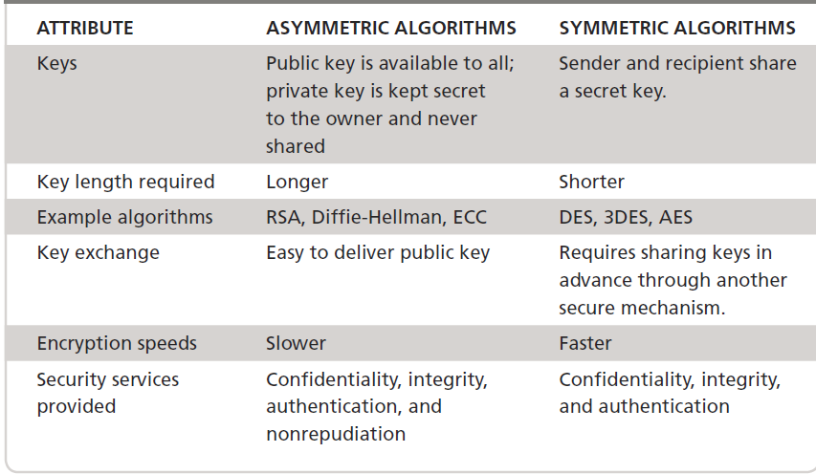
Symmetric Versus Asymmetric Algorithms

Slide 22
Certificate Authority (CA)
Is a trusted organization that maintains, issues, and distributes digital certificates
Uses the X.509 digital certificate standard to create certificates

Slide 23
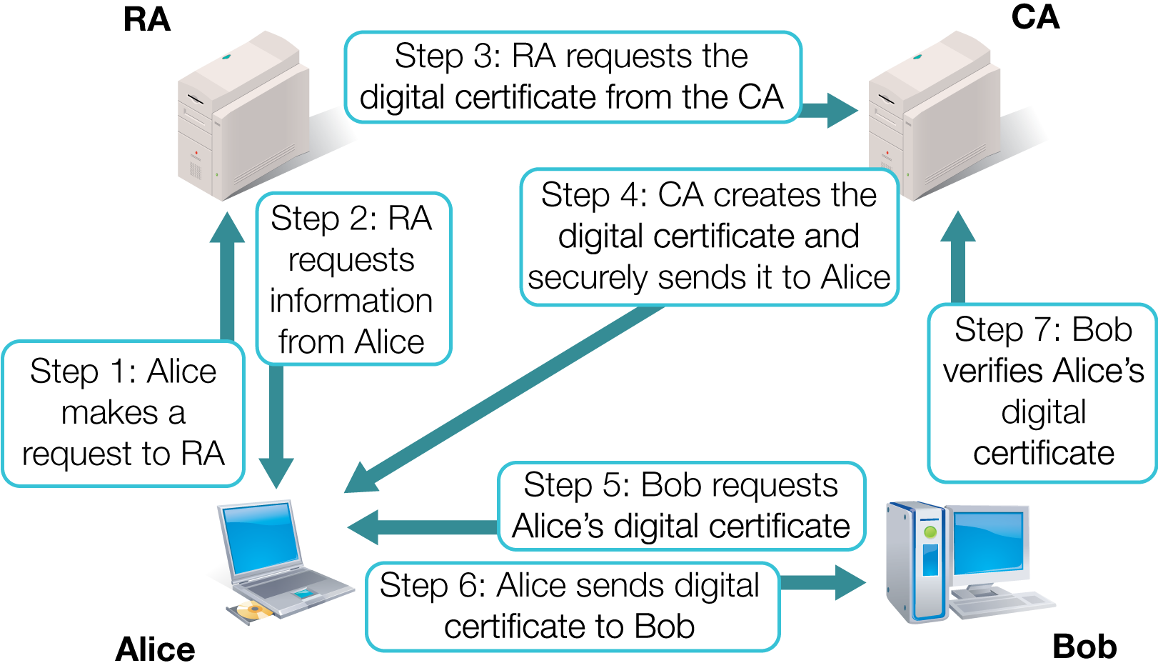
CA in a PKI System

Slide 24
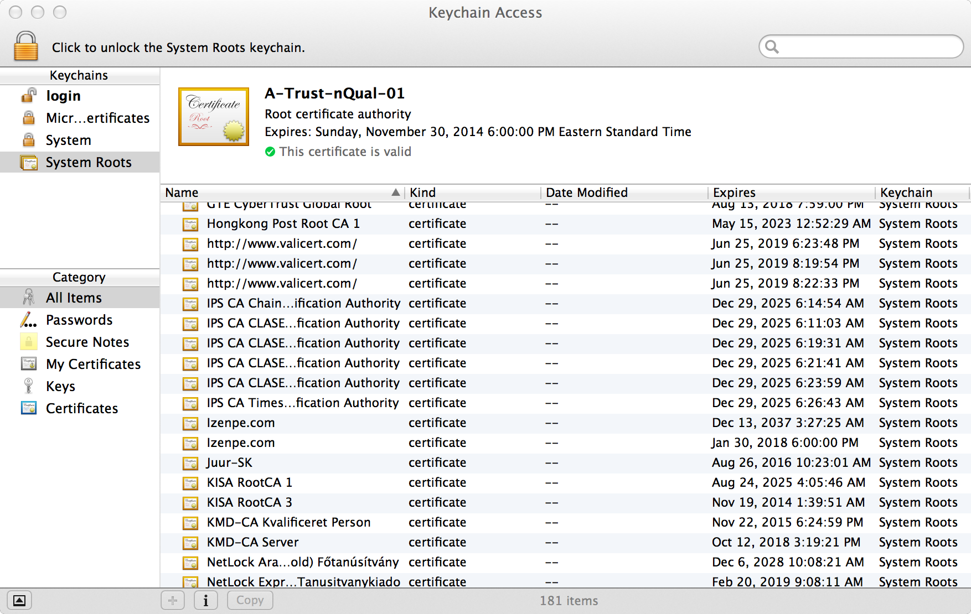
Trusted Certificate Authorities

Slide 25
What PKI Is and What It Is Not
Is a strong authentication mechanism
Provides integrity, confidentiality, authentication, and nonrepudiation in a single framework
Is not an answer to all security questions or concerns
Does not provide authorization
Does not ensure that the end user can be trusted

Slide 26
Potential Risks Associated with PKI
If PKI key management is mishandled, entire PKI system could fail
Managing a secure environment with multiple keys and multiple entities can be overwhelming
Properly maintaining a PKI comes with a financial burden

Slide 27
Implementations of Business Cryptography
Encrypting hard drives as a preventive measure in case a laptop or other mobile device is stolen
Encrypting removable devices such as universal serial bus (USB) drives
Encrypting instant messaging communication
Encrypting file transfers within and outside of the network
Encrypting highly sensitive data
Encrypting information on mobile devices

Slide 28
Certificate Authorities (CAs) Functions
Policy authority
Certificate manufacturer
Certificate issuer
Revocation manufacturer
Registration authority
Authentication service
Repository

Slide 29
Week 14 Assignment
Implementing various technologies and addressing remote access concerns ensures your systems and data are protected. Some of the technologies used in remote access are RADIUS, RAS, TACACS+, and VPN.
Using this course rules of writing, please address each of these technologies with a minimum of two paragraphs on each. In writing about these remote access methods, please include the role they play as it relates to the organization network security. Each section should have at least four (4) complete sentences, as well as a different citation supporting the presented claim. The SafeAssign score should not be more than 30%.
Notes:
If your educational institution included the Jones & Bartlett labs as part of the course curriculum, use this script to introduce the lab:
"In this lesson, you learned that public key infrastructure (PKI) and encryption employ technologies and algorithms that provide a secure system for the transmission of data. You learned the risks associated with PKI and best practices for the use of PKI within large enterprises.
In the lab for this lesson, you will use GnuPG (GPG), a free encryption utility, to generate a public key to encrypt and decrypt a message. You also will use PKI to send secure messages between two user accounts and verify the integrity of the received files."

Slide 30
Week 15 Assignment
For this assignment, list and discussed the four (4) security services provided by public key infrastructure (PKI) according to the course reading material. Please write at least two paragraphs on each. Additionally:
Write 2 to 3 paragraphs (In the third person) on the following:
What was most compelling to you in this course?
How did participating in the discussion board enhance your learning abilities?
Is there anything you are uncertain about as it relates to Access Control?
Respond to at least two classmates’ posts with no less than 100 words.

Slide 31
Week 16 Assignment
100 multiple choice questions

Slide 32
Conclusion
It was a pleasure having you.

