Slide 1
Micro-grid Smart City your name
Au]hor

Slide 2
Agenda
Background
Problem
gap
Objective
solution
Conclusion

Slide 3
Background
A smart city is an urban area that uses different types of electronic data collection sensors to supply information which is used to manage assets and resources efficiently.

Slide 4
Problem
1-The result of our centuries-old model of city growth is increase rapidly inequality. We’re now in a situation wherein the political, economic and social environment is fractured, many citizens distrust elected officials to act on their behalf, and government bureaucracy is seemingly unable to provide efficient and effective services. Needless to say, that’s undesirable on many levels.
We continue to build cities that are net contributors to the very problems we seek to solve. Our cities get bigger, commute times get longer, and the impact on our environment gets worse. What do we do? We build bigger roads and provide services further away from where people live and don’t take rational environmental action.

Slide 5
Gap
When people use electricity in their homes, the electrical power is probably generated by burning coal or natural gas, by a nuclear reaction, or by a hydroelectric plant on a river, to name just a few sources. When people fill up a car’s gasoline tank, the energy source is petroleum (gasoline) refined from crude oil and may include fuel ethanol made by growing and processing corn. Coal, natural gas, nuclear, hydro power, petroleum, and ethanol are called energy sour.
nonrenewable energy sources can be used as primary energy sources to produce useful energy such as heat or used to produce secondary energy sources such as electricity

Slide 6
objective Energy in Smart Cities
Energy powers the Technologies which are the foundations of Smart City.
Assuring 24X7 Power to all Smart Cities
Energy should be operated with completely Smart Grid Technology.

Slide 7
Renewable Energy Source
Renewable Energy source are the sources that naturally renew, or replenish themselves.
The Following energy sources are considered renewable energy sources
Solar Energy
Wind Energy
Geo Thermal
Bio Mass
Hydro Power

Slide 8
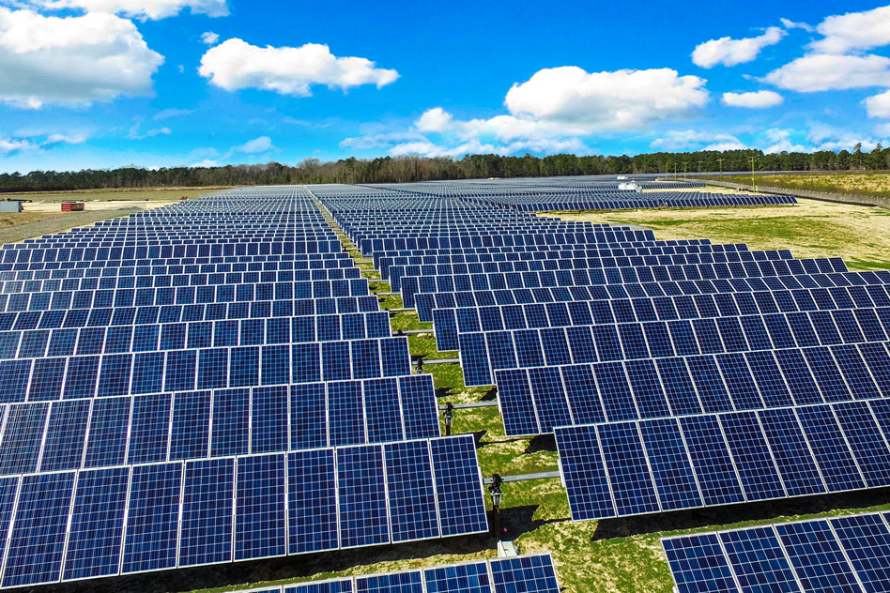
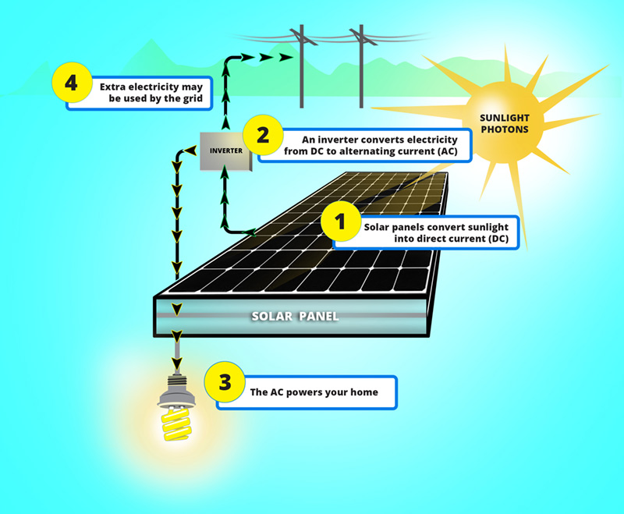
Solar Power
Using the power of sun to generate electricity.
Solar Cell convert the photo energy into electricity.

Slide 9
Solar Energy Advantages and Disadvantages
Advantages:
Renewable Energy Source
Low Maintenance Costs
Reduces Electricity Bills
Disadvantages:
Cost
Weather Dependent
Uses a Lot of Space

Slide 10
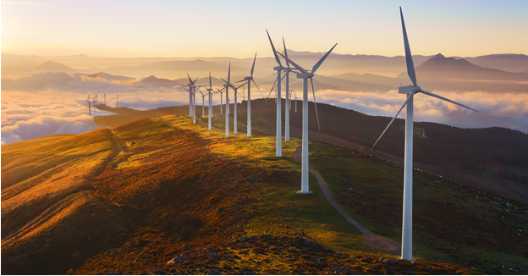
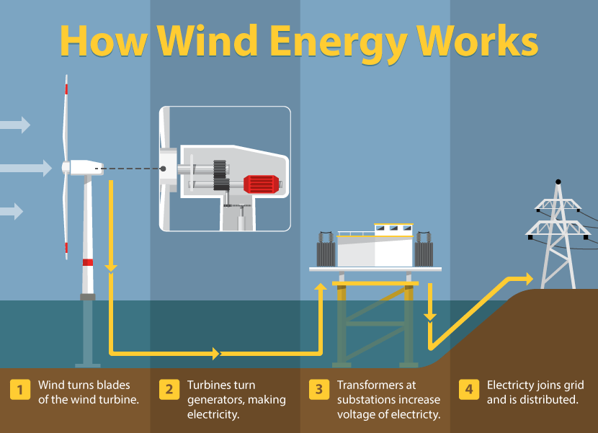
Wind Energy
Wind turns the windmill blades
Mechanical motion converted to the shaft of a generator, producing electricity

Slide 11
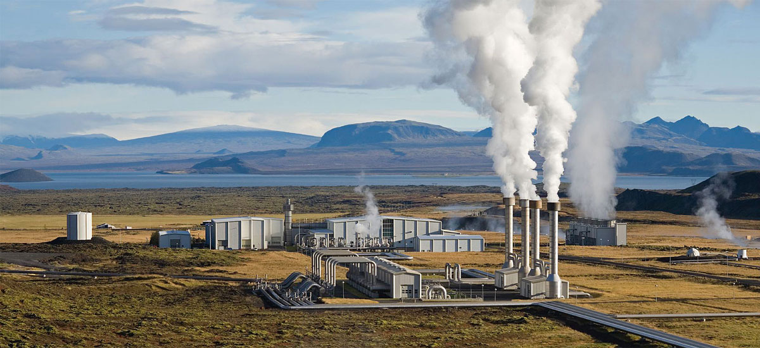
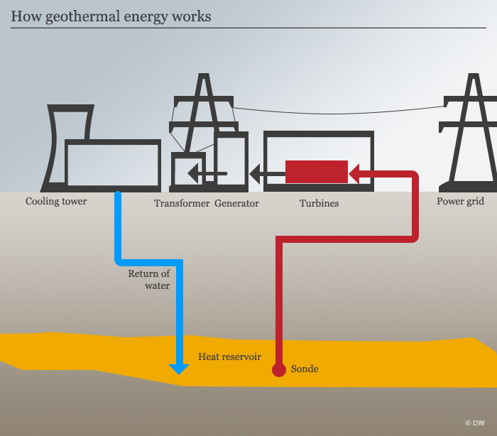
Geo Thermal
Geothermal energy is the heat from the Earth.
It's clean and sustainable
Dig a very deep hole and pass the fluid to convert into steam
Use the steam to generate electricity

Slide 12
solution
Energy Communication Interface Unit
Electricity usage, costs and control
Manage huge volume of data
Tools to help the consumers control their usage so they can lower their bills
Management of the peak loads by reducing the demand
Help consumers to manage their usage and power bills
ECI
In-Home Display Units
Single Communication System handling power in the smart cities
Power Theft Detection

Slide 13
Energy on Smart Grid Technology
Electricity usage, costs and control
Manage huge volume of data
Tools to help the consumers control their usage so they can lower their bills
Management of the peak loads by reducing the demand
Help consumers to manage their usage and power bills
How much energy is needed and helps utility to lower the purchased power cost.
Financial incentives to companies that reduce their load in response to a request.
A smart city having a smart technology based grid should be provided with Ultra high speed internet, voice and video access to all the consumers, City wide Wi-Fi network for city and utility, Street light controls, Surveillance cameras. This will help to manage automatic outage and faults in an elegant manner.
.

Slide 14
Power Usage in smart city
For a 29 days month = 802.565 KWh
For a 30 days month = 810.757Kwh
For a 31 days month = 819 .632KWh

Slide 15
Conclusion

Slide 16
Thank You

