Slide 1
Winter Weeks 3-8: Labour in International Supply Chains
Sweatshops and Fair Trade

Slide 2
Labour in supply chains: introducing the issues

Slide 3
Bad Work: Some Examples
When and where did each of the following examples of sweatshop conditions take place?
Notes:
<number>

Slide 4
Example I
“Children of nine or ten years are dragged from their squalid beds at two, three, or four o’clock in the morning, and forced to work for subsistence wages until ten, eleven, or twelve at night, their frames dwindling, their faces whitening, and their humanity sinking into a stone-like torpor, utterly horrible to contemplate.”

Slide 5
Example 2
The garment factory employed 500 workers, mostly young women, working 9 hours/day on weekdays and 7 hours on Saturday.
Doors to stairwells and exits were kept locked to prevent workers from sneaking out early.
A fire on the 8-10th floors killed 146 workers. Many of the workers, clothes on fire, jumped to their deaths from the windows.

Slide 6
Answers
1.England. From 1860 report on conditions in lace making industry
2. New York City, 1911. Triangle Shirtwaist (blouse) Factory fire.

Slide 7
Supply Chains
Most branded consumer products not made by brand owner
Vertical disintegration/ outsourcing
E.g. iPhone components, subcomponents from many different countries
Sub-sub contracting in apparel
Chains long, branching, hard to monitor
Workers treated better by suppliers more closely linked to brands (direct suppliers, regular suppliers)
(Locke, Kabeer)
Notes:
<number>
http://www.globallabourrights.org/reports?id=0397

Slide 8
Concerns re supply chain labour
Low wages
Dangerous working conditions
Abuse of workers
Child labour
Can cause high profile CSR issues: e.g. GAP, Nike, Liz Claiborne, Walmart, Joe Fresh etc.
CSR/Policy issue: what to do about these?

Slide 9
The Cost of $65 Nike Shoes:
Labor Costs $2.43
Manufacturer’s Overhead $2.10
Materials $10.75
Profit to factory $0.97
Factory price to Nike $16.25
Wholesale price $32.50
Retail price $65
Notes:
<number>

Slide 10
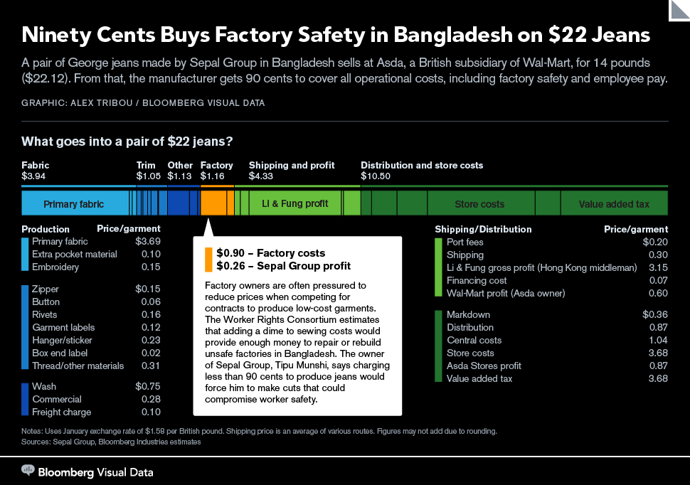
Notes:
http://www.bloomberg.com/infographics/2013-06-05/90-cents-buys-factory-safety-in-bangladesh-on-22-jeans.html
Li and Fung is a supply chain management firm http://www.lifung.com/what-we-do/
Sepal Group is a Gazipur manufacturer that supplies about 20 brands http://www.sepalgroupbd.com/about_us.php
<number>

Slide 11
Low wage supply chains and “throw away society”
Cheap labour →
Real prices of apparel and consumer electronics declining
Becoming “disposable” items
→ waste, environmental impact

Slide 12
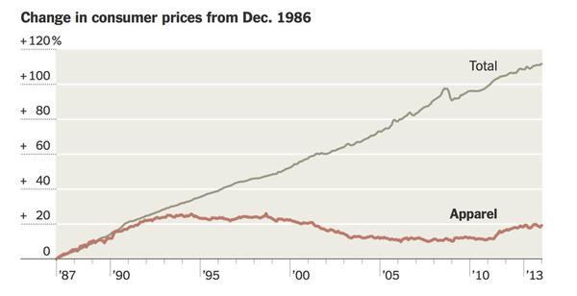
Apparel prices vs other prices
Notes:
https://elizabethsuzann.com/blogs/stories/money-talk
<number>

Slide 13
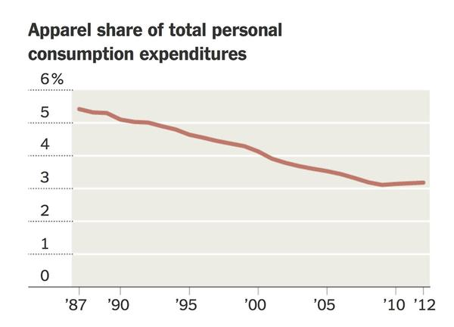
Notes:
https://elizabethsuzann.com/blogs/stories/money-talk
<number>

Slide 14
Throw-away society and low wage labour
Short product life cycle →
Rapid style change and product differentiation and/or price promotion/ competition →
Just-in-time inventory systems →
Pressure for fast, flexible low-cost delivery by suppliers →
Low wages, extreme overtime when rush orders come in

Slide 15
CSR debate: Issues
Can voluntary CSR (corporate, business association, or joint business/NGO) social responsibility codes make a positive difference?
Can corporate initiatives and civil society pressure benefit poor given global wealth/power inequalities?
Can civil regulation change the system?

Slide 16
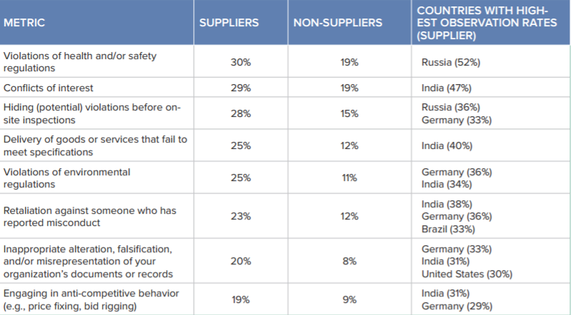
Ethics & Compliance Risk in the Supply Chain
ECI (2016) p.6
Notes:
http://www.ethics.org/ecihome/research/gbes/supply-chain/supply-chain-download
<number>

Slide 17
Supply chains: ethical interventions
What is the role of Ethical consumption?
The role of voluntary standards and certification [auditing approach]
The role of Fair Trade?
The role of law?

Slide 18
Fair Trade approach
FT arrangements: paying above-market prices to co-ops of small producers of commodities
Usually agricultural commodities (coffee, sugar, cocoa, bananas, cotton) or sometimes artisanally extracted minerals (e.g. gold)
Sometimes includes commodities produced by large operators who pay well, etc.

Slide 19
Supply chain auditing vs FT
Cross (2011): FT is about creating relationship between producers and consumers
Ethical auditing is about “ethic of detachment”: formal standardized rules imposed on interchangeable suppliers re: specific bounded aspects of workplace and labor relations
Notes:
<number>
Jamie Cross “Detachment as a corporate ethic: Materializing CSR in the diamond supply chain” Focaal—Journal of Global and Historical Anthropology 60 (2011): 34–46

Slide 20
Fair Trade Cotton Paradox
FT programs pay premium price for commodities produced by small producers
Commercial cotton produced on vast mechanized farms
FT cotton produced by peasants in poor countries like Burkina Faso
BUT even paid FT prices, may use ill-treated child labour
Notes:
<number>
Cam Simpson “Victoria’s Secret revealed in child picking Burkina Faso cotton.” Bloomberg
http://www.bloomberg.com/news/2011-12-15/victoria-s-secret-revealed-in-child-picking-burkina-faso-cotton.html

Slide 21
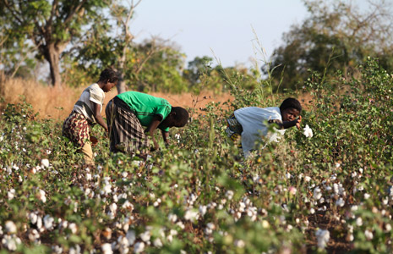
Child workers on small FT cotton farm in Bukina Faso
“Good for women,” read a booklet accompanying a white thong covered with blue and lavender daisies. “Good for the children who depend on them.”

Slide 22
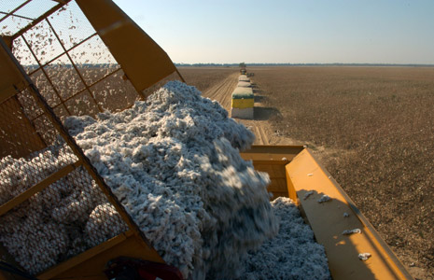
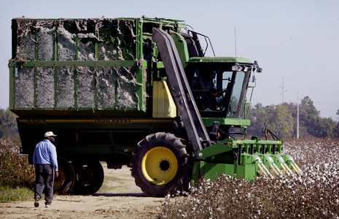
Capital-Intensive Industrial Cotton Production
Notes:
<number>
http://www.bloomberg.com/news-media/clarisse-kambire-victorias-secret-child-labor-cotton-picker/

Slide 23
Organic FT vs Industrial Cotton: Which is more socially responsible?
Organic FT
Low input, low impact
Sustainable?
Labour-intensive
Employs many
Low wages
Child labour
Hard work
High price to consumer
Industrial
High input, impact
Energy, groundwater, fertilizer, pesticides
Capital intensive
Unsustainable?
Employs few
Pays well
Low price to consumer

Slide 24
FT Criticism 1: Distorts Market
Market price (in theory?) reflects marginal demand
Paying more sends price signal that more of commodity needed→ excess production
E.g. Body Shop sourcing of FT shea butter in Ghana → too many people go into growing shea → over-supply
Coffee FT crit.: FT benefits a few producers but adds to glut that depresses price for all
Reply?

Slide 25
FT Criticism 2: “Charity”
Market price is the “price”, what is paid above that is “charity”
So, why not buy cheaper non-FT product and give the difference to charity?
Why does the producer deserve this charity more than other disadvantaged person?
Reply?

Slide 26
What about CSR voluntary standards approach?
Focus of next few weeks
Connects with CSR debate discussed first term

Slide 27
CSR Debate: Skeptical positions
Left: CSR codes for show, not intended by business to make a difference because profit motive
Right: CSR codes, if effective, would hurt intended beneficiaries by distorting labour markets
Pragmatic: CSR codes well meaning but may be poorly conceived, hard to implement effectively, have negative consequences

Slide 28
CSR Debate: Pro-CSR position
Markets shaped by social norms [neo-institutionalist view]
CSR changes context of profit seeking
Alternatives (state, labour movement) no less compromised by inequalities
CSR more effective or needed to complement alternatives

Slide 29
Week 4
Implementation dilemmas: Voluntary initiatives and codes: nature and limitations

Slide 30
Child labour in international supply chains
Soccer balls
“Putting out” cottage production in Sialkot, Pakistan targeted by “Foul Ball” campaign
Hand-knotted rugs
Chocolate
Issues of child slave labour in W. Africa, esp. Ivory Coast

Slide 31
Child labour rates: region and sector (ILO 2013)
<number>
Notes:
Marking Progress Against Child Labor (2013) ILO/IPEC http://www.ilo.org/wcmsp5/groups/public/---ed_norm/---ipec/documents/publication/wcms_221513.pdf
<number>

Slide 32
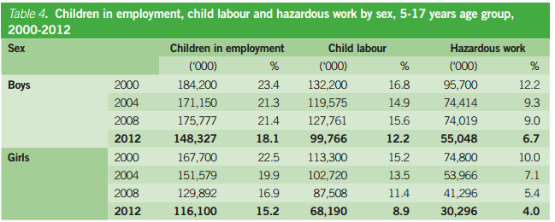
Child labour rates: year and sex (ILO 2013)
<number>
Notes:
Marking Progress Against Child Labor (2013) ILO/IPEC http://www.ilo.org/wcmsp5/groups/public/---ed_norm/---ipec/documents/publication/wcms_221513.pdf
<number>

Slide 33
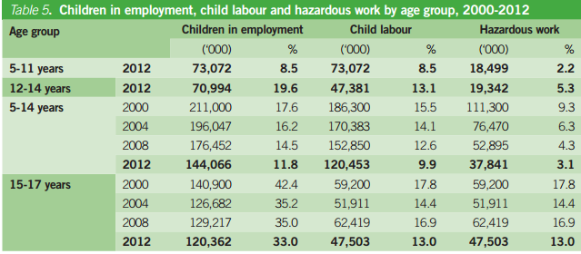
Child labour rates: year and age (1LO 2013)
<number>
Notes:
Marking Progress Against Child Labor (2013) ILO/IPEC http://www.ilo.org/wcmsp5/groups/public/---ed_norm/---ipec/documents/publication/wcms_221513.pdf
<number>

Slide 34
How to address child labour?
Does getting rid of child labour from supply chains benefit child workers?
Why/when?
Soccer balls
“Putting out” cottage production in Sialkot, Pakistan targeted by “Foul Ball” campaign
Much production moved to China or urban factories→ negative impact on village families

Slide 35
Rugs: Certification Programs
Goodweave founded in 1994 in India as Rugmark
Rebranded as Goodweave in 2009
“In order to earn the GoodWeave label, rug exporters and importers must be licensed under the GoodWeave certification program and sign a legally binding contract to:
Adhere to the no-child-labor standard and not employ any person under age 14
Allow unannounced random inspections by local inspectors
Endeavor to pay fair wages to adult workers
Pay a licensing fee that helps support GoodWeave’s monitoring, inspections and education programs”
Notes:
<number>
http://goodweave.org/about/child_labor_free_rugs

Slide 36
Rugmark (Goodweave) criticisms
Child labour rules for cottage industry unenforceable in practice
Just provides “cover” for importers
Real problem is failure of government to provide education & opportunity for poor low-caste children

Slide 37
Voluntary Codes and Multi-stakeholder initiatives (MSIs)
1) industry-dominated MSIs
2) multi-lateral, rich country based MSIs
3) local NGO/ labour movement led MSIs
E.g. Salvadoran Independent Monitoring Group

Slide 38
1) Industry dominated MSIs
E.g. World-wide Responsible Apparel Production (WRAP).
Limited participation by civil society actors, stakeholders—some representation in organizations, mainly endorsement

Slide 39
2) Rich country NGO led/ Industry funded MSIs
E.g. Social Accountability International (SAI), Atlanta Agreement, ETI
More credibility than industry-led because ostensibly arms-length relationship to business, but may be co-opted by industry because of need for business funding and buy-in

Slide 40
MSIs formed after Rana Plaza collapse
Accord on Fire and Building Safety in Bangladesh
Multi-lateral MSI
Legally binding agreement
Inspection reports posted on website
H&M, A&F, Joe Fresh, Benetton, IndustriALL union
OECD, UN, ILO
Alliance for Bangladesh Worker Safety
Industry dominated MSI
Information sharing, boycott of non-complying facilities, worker complaint hotline
Canadian Tire, Walmart, HBC
Retail Council, Bangladesh govt.

Slide 41
Ethical Trading Initiative ETI
Participating companies commit to following ILO standard Base Code labour standards OR host country legal labour standards whichever is higher

Slide 42
3) Local NGO led MSIs
E.g. Salvadoran Independent Monitoring Group arrangement with Liz Claiborne and Gap
Better understanding of local conditions and priorities
But: may have trouble organizing, getting attention of consumer markets necessary for market based civil regulation
May not be representative of most disadvantaged stakeholders (e.g., women, youth, minorities or low caste, etc.), marginalized within local communities and organizations.

Slide 43
Week 5
Labour in supply chains continued: Implementation problems and systematic studies

Slide 44
Problems with Codes & Auditing
Focus on specific issues as identified by NGOs etc, and framed by 1st world priorities:
E.g. high profile human rights issues, not mundane labour concerns
May be counterproductive
E.g. enforcing child labour laws may reduce, not help child welfare and education
Limiting work hours may increase poverty of workers paid by hour or piecework
“checklist” approach to auditing

Slide 45
Social audit limitations 1
Quick in-out audits by small teams (unlike regular presence of local NGOs, unions) may miss problems;
firms can “clean up” worksites;
no off-site interviews so workers can be intimidated

Slide 46
Social audit limitations 2
Auditors based in US or UK using standardized method—doesn’t reflect local context
Foreign auditors used because more objective and neutral than local NGOs but may be biased to companies
E.g: sexual harassment: if asked yes/no question on questionnaire, workers may say “no” because they regard it as “normal”—so auditing requires consciousness-raising rather than “objective” method to be actually neutral

Slide 47
Social audit limitations 3
Confidentiality as a condition of company participation (they don’t want stakeholders to know if they don’t pass) means audits can’t be independently verified by locals

Slide 48
The Big Squeeze on suppliers
Buying departments of big consumer goods and retailing firms use monopsony power to demand ever-lower prices, short turn-around time, frequent style changes, etc.
Their CSR departments demand paying better wages, better working conditions, no excessive overtime
If you can’t please both departments, please the one that is more powerful (usually not CSR!)

Slide 49
2012 Apparel Factory Fires
12 September: Ali Enterprises, Karachi Pakistan– 300 killed
24 November: Tazreen Fashion, Dacca Bangladesh (Walmart supplier)—112 killed
’factory received an “orange” rating from Walmart in May 2011, because of “violations and/or conditions that were deemed to be high risk.”’*
Facts of both similar to Triangle fire: fire hazards, locked exits, victims jumping from upper floors
Notes:
*Josh Eidelson “Photos Show Walmart Apparel at Site of Deadly Factory Fire in Bangladesh The Nation 26 Nov. 2012
http://www.thenation.com/blog/171451/photos-show-walmart-apparel-site-deadly-factory-fire-bangladesh#
<number>

Slide 50
Auditing Problem: Case in Point—Ali Enterprises fire
Karachi factory fire 11 Sept 2012 killed 300
Bad wiring → electrical fire
Exits, fire escapes locked to prevent pilfering and workers leaving early
Stairwells used for storage→ impassible
Windows boarded up
Owners charged but out on bail, case proceeding slowly impeded by corruption, owners’ connections
Notes:
http://www.dawn.com/news/1143540
<number>

Slide 51
Social Accountability Int’l Review
partners with unions, local NGOs, organic, fair trade, and environmental organizations, development charities, and anti-corruption groups
develops consensus-based voluntary standards, accredits auditors, provides training and technical assistance
1997, launched SA8000 – a voluntary standard for workplaces, based on ILO and UN conventions
Notes:
http://www.sa-intl.org/index.cfm?fuseaction=Page.ViewPage&pageId=490
<number>

Slide 52
Ali Enterprises audit
Ali Enterprises certified by Social Accountability International as complying with SA8000 code
Ali facility audited in August 2012 by RINA (Registro Italiano Navale Group) on behalf of SAAS (Social Accountability Acreditation Services)
RINA had done only paper audits—documents turned out to be ‘issued’ by non-existent inspection firm
Notes:
http://www.sa-intl.org/index.cfm?fuseaction=Page.ViewPage&PageID=1341
http://www.sa-intl.org/_data/n_0001/resources/live/SAIReportAddendum_FireSafetyinPakistanandWorldwide.pdf
<number>

Slide 53
Ali Enterprises fire: labour movement response
Management intimidated workers to lie to SA inspectors re safety conditions
Fire shows that auditing is no substitute for worker empowerment via unions
Union organizers face employer retaliation, entrenched class power in Pakistan
Notes:
http://www.industriall-union.org/unions-are-best-way-to-prevent-further-disasters-in-pakistan
http://www.dawn.com/news/1143540
<number>

Slide 54
Ali fire update
Sept 2016: German retailer KiK agrees to compensate survivors for medical expenses and lost income
Total ~$6 million
Call for better laws and social safety net
Negotiated by KiK, IndustriAll Union, Clean Clothes Campaign
Negotiations enabled by German & Pakistani governments, ILO
Notes:
https://cleanclothes.org/news/2016/09/12/statement-ali-enterprises
http://www.ilo.org/global/about-the-ilo/newsroom/news/WCMS_521510/lang--en/index.htm
<number>

Slide 55
Review: Seidman
“These dilemmas are structural, linked to the very fact that the regulatory system is voluntary and privatized, and that the independent monitors involved depend on corporations for every facet of the process: for funding, for access to factories, and for long-term pressure on sub-contractors. Moreover, in a global, voluntary process, employers know that consumers cannot tell the difference between monitors, …most firms will make a less-demanding choice.”
Seidman (2008): 1000

Slide 56
WEEK 5
Systematic studies: what works

Slide 57
Approaches to supply chain compliance
Compliance model
Audits as policing →punishment of non-compliant suppliers
Capability building model
Audits as problem solving
Providing suppliers with technology and training to improve production & management →safer, more productive workplaces

Slide 58
Limits to capability approach
Works best re suppliers with close relation to brand, not arms-length subcontractors
Locke: Nike Mexico plants e.g.
Doesn’t address “big squeeze”—no incentive to turn productivity gains into higher wages

Slide 59
Social norms, outsourcing and exploitation
Recent research (Appelbaum 2017) on domestic (i.e., not transnational) supply chains suggests norms limit exploitation of direct employees
Supports neo-institutionalist view
Outsourcing lets firms (indirectly) pay less for same work in same country
Supports amoral calculator view
Reconciles neo-institutionalist and “amoral calculator” theories of corporate behaviour?
Notes:
Eileen Applebaum (2017) "Domestic Outsourcing, Rent Seeking, and Increasing Inequality" Review of Radical Political Economics, Vol. 49(4) 513–528
<number>

Slide 60
Regulation and voluntary labour standards effectiveness
Toffel et al re: compliance with voluntary labour codes
Independent variables:
International NGOs,
local regulations
Treaty ratifications
Free press
Together have significant effect on code compliance, little separate effect
Notes:
M. Toffel, J. Short and M. Ouellet 2012 “Reinforcing regulatory regimes: how states, civil society, and codes of conduct promote adherence to global labor standards” Harvard Business School Working Paper 13-045
<number>

Slide 61
Toffel et al findings
Effect of variables “interactive not additive”– individually have little effect
One not substitute for other
E.g., free press + NGOs effective but not either individually
Strong local law + treaty ratification effective, but not either individually
Evidence that home country civil regulation → compliance in host country

Slide 62
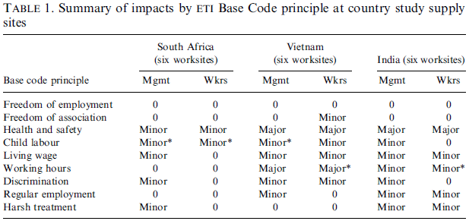
Barrientos & Smith (2007) findings (p. 721)

Slide 63
Garvey & Newell findings: factors affecting CSR performance
Relative power of corporation and host government
Host country laws
Host community skills, cohesiveness, vs inequality and conflict
Attitudes to CSR in company home country
Company culture [see previous lectures]

Slide 64
Complementarities upshot
CSR most effective in countries with strong labour and transparency laws
Competing firms face stronger “race to bottom” pressures than governments; governments can help firms escape

Slide 65
Week 6
The sweatshop normative debate I

Slide 66
Normative Issues:
Is it socially irresponsible for companies to use sweatshop labour?
Should they adopt voluntary standards/codes for wages and labour conditions higher, or pay the market wage?
Should importation of sweatshop produced goods be legally restricted?

Slide 67
Arguments against high labour standards
1. Sweatshops pay more than other jobs workers could get
2. If firms had to pay more, they would hire fewer workers, so while some workers (hired for more pay) would be better off, others (not hired) would be worse off.
3. If sweatshops allowed, eventually competition for labour will raise wages

Slide 68
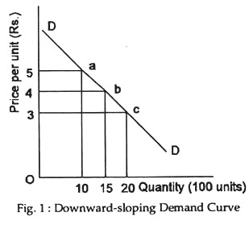
Economic Assumption
“Downward-sloping demand curve” = as price goes up demand goes down
Remember from intro Microeconomics?

Slide 69
Downward Sloping Demand Curve Applied to Labour
Higher wage→ lower employment
Standard argument against increasing minimum wage
Is it true??
Sweatshop worker wage small part of final price
If passed on to consumer, would it reduce demand?
Make automation more attractive?

Slide 70
Implication for sweatshops
Unless consumers willing to pay more for no-sweat goods, voluntary codes against sweatshops must reduce employment, because if price goes up people will buy less.
Otherwise, firm can only pay higher wage by improving productivity (i.e., reducing labor demand)

Slide 71
Pro-standards counterargument
Argument that anti-sweatshop codes reduce employment based on premise that “labor demand curves are downward sloping” BUT
-there is no empirical evidence for this in sweatshop context
- implausible, as e.g. doubling wage would add $0.50 to $32 shirt

Slide 72
Pro-standards counterargument, cont.
Added costs don’t necessarily result in lower employment: can be passed on to consumers (esp. if there are voluntary codes that cover most competitors) or absorbed through lower profits or lower home office pay.

Slide 73
What about non-wage standards?
Complying with local (usually not enforced) labour laws would not require reduced hiring, and (esp.) working conditions can often be improved at little cost → no loss in employment
Rejoinder: insofar as improving conditions costs $, it is part of compensation:
trade-off between wages and conditions, workers may prefer wages

Slide 74
Productivity Wage Issue
Pro-Standards argument: Improving wages not necessarily costly to firm as could increase productivity
Reply: “efficiency wage” arguments don’t typically apply in 3d word sweatshop settings; if firms could make more $ by improving conditions they would already have

Slide 75
Argument that Market Forces will Eliminate Problem without Standards
Claim: Sweatshops are a response to labour surplus, low productivity; natural part of early phase of industrialization
Jeffery Sachs: “concern [re Africa] is not that there are too many sweatshops but that there are too few.''

Slide 76
Reply to “Market will End Sweatshops” Argument
Market forces alone don’t end sweatshop stage of development—growth is joined with changes in law and policy
e.g. labor laws and unions ended sweatshops in US during post-war era, while lack of law enforcement and decline of unions lead to return during neo-liberal era

Slide 77
Week 7
The sweatshop normative debate II: exploitation

Slide 78
Exploitation Issue
What is exploitation?
Port of Caledonia e.g. (tug offers disabled ship a pull for a high price—ship sues and gets $ back)—win-win, but unfair division of surplus?
Better off exploited than not?

Slide 79
Exploitation: Snyder
Micro Unfairness
Violation of narrow CSR
Macro Unfairness
Taking advantage of structural inequality
Issue: how much does a business need to do to correct structures it didn’t create?
“Mere use”: worker as means only, not an end
Bowie → “living wage”
Snyder “perfect form of duty of beneficence”
<number>

Slide 80
Micro-unfairness
Micro-unfairness = violation of market norms: coercion, deception
Micro-fairness = win-win relative to other options
Doesn’t take into account background constraints, structural injustice
Zwolinsky: why blame firms that use sweatshop labour & benefit poor even a little, but not “responsible” firms that don’t benefit poor at all?

Slide 81
“Desperate Bargains” Response
Sweatshop workers are better off than in alternative, but because alternative so bad, terms of the transaction “of last resort” should be subject to standards
Rejoinder: removing last resort makes the set of alternatives even worse
Reply: Depends on whether last resort is removed or just improved.

Slide 82
“Mere Use”: Respect for Persons
Employers have moral obligations to workers, to treat them as ends in themselves, pay a country-specific living wage
these obligations also apply to employees of subcontractors, because MNCs have more bargaining power and can dictate terms of contracts

Slide 83
Rejoinder to Respect Argument
If no coercion or deception in hiring, and terms of contract honoured, (arguably) arrangement respects workers’ autonomy (Zwolinsky)
What about obligations of potential employees not hired if labour standards must be raised? [Assumption re elasticity of demand?]

Slide 84
Zwolinsky on Respect Argument
Morally wrong to prohibit sweatshop employment, as it would interfere with freedom of workers to choose that kind of job, and keeping them from signaling preference/getting something that would make them better off

Slide 85
Macro-unfairness
Taking advantage of background conditions due to past injustice
Eg. colonialism
Macro-fairness = hypothetical transaction if both parties had other options that would allow decent standard of living
Problems:
How is macro-fair background determined?
Why is macro-fairness responsibility of firm?

Slide 86
“Sweatshop World” vs “CSR World”
In Sweatshop World:
Marie in Haiti works 12 hr days for under $2/day in dirty crowded sewing shop making t-shirts for Gildan sub-contractor,
dangerous dust levels,
pregnancy tests, harassment etc.;
Gildan makes >20% return on equity

Slide 87
In CSR World
Gildan never closed plants in Que.,
Pays decent wage in clean plants, or has good plants in high-productivity countries
Treats workers with respect.
Marie not employed in Gilden sweatshop, makes $1 day as agricultural laborer or garbage gleaner.

Slide 88
Question
Which world would Marie prefer, Sweatshop World or CSR World?
Recall John Rawls’s “difference principle”: what is just is what benefits worst off
Claim: worst off are not sweatshop workers, but those who would work in sweatshop if they could

Slide 89
CSR World vs Sweatshop World: Micro vs Macro Issues
Sweatshop defenders make good case re Marie’s situation assuming set of options facing her is fixed, and firm is only deciding between hiring more workers for less $ or fewer for more.
Introducing sweatshop doesn’t usually eliminate other options in itself
But this focus overlooks other ways corporations (etc.) do affect alternatives

Slide 90
Examples
Andre Apaid (major Gildan sub-contractor) involved in Haiti coup
Agricultural subsidies, dumping, protectionism → undermining LDC agriculture
Violence, repression of labour

Slide 91
Normative implications neglected by most CSR codes
“Sweatshops” per se not problem?
CSR needs to emphasize process not just substantive gains (Barrientos & Smith)
Encouraging & supporting, not resisting & repressing independent labour movement and host country regulation
Host country law influenced by trading partners’ law (Mosley)
Longer term relationships with suppliers, not shopping around, frequent switching

Slide 92
CSR as political responsibility (Young)
Shared responsibility to bring about just structures
Forward-looking, so not dependent on whether firm is to blame for unjust structure
Responsibility can be met in various ways—doesn’t impose perfect duty

Slide 93
Summing up: Kinds of fairness and normative CSR theories
Micro-fairness: demanded by stockholder, stakeholder, and market failure theories
No “mere use”: Kantian stakeholder theory (Bowie);
Zwolinski thinks respect for persons only entails micro-fairness
Macro-fairness: some kinds/aspects of stakeholder and market failure theories?
Challenge to standard approaches to stakeholder theory

Slide 94
Week 8
Alternatives and worker perspectives

Slide 95
Alternatives to voluntary codes
Host country law
Brand home/consumer country law
Incorporation of social clause in international trade agreements, WTO
Enforced by trade sanctions
Organized labour action

Slide 96
Host Country law
Problems:
Enforcement
Competitive pressure (“race to the bottom”)

Slide 97
Home/Consumer Country Law Initiatives
E.g. California Transparency in Supply Chains Act
UK Modern Slavery Act
Focus on auditing and disclosure re worst abuses in supply chain
Canadian proposed Act to Prohibit Sweatshop Labour Goods private member’s bill
Broader scope, stronger measures

Slide 98
California Transparency in Supply Chains Act 2010
Firm with >$100M in sales must “disclose… its efforts to eradicate slavery and human trafficking from its direct supply chain for tangible goods offered for sale”
Must audit suppliers (pref. unannounced, 3d party).
Make suppliers certify that inputs comply with host country slavery & trafficking laws
Notes:
http://www.state.gov/documents/organization/164934.pdf
<number>

Slide 99
U.K. Modern Slavery Act 2015 s. 54
Applies to all “commercial organizations” with revenues above amount set in regs
Firm must issue:
(a) a statement of the steps the organisation has taken during the financial year to ensure that slavery and human trafficking is not taking place—
(i)in any of its supply chains, and
(ii)in any part of its own business, or
(b) a statement that the organisation has taken no such steps
Notes:
http://www.legislation.gov.uk/ukpga/2015/30/section/54/enacted
<number>

Slide 100
A Canadian Legislative Initiative
Act to Prohibit Sweatshop Labour Goods
Private member’s Bill C- 378 introduced by Peter Julian, NDP
Introduced Nov. 2009 as Bill C-463; Re-introduced March 3, 2010, and reinstated 2011, 2013
Died at end of session in 2015

Slide 101
Bill C-378 Key Provision
3. (1) The Governor in Council [Cabinet] may…make an order adding a good to the List of Prohibited Imports…, if the Governor in Council is satisfied that the good was produced, manufactured or assembled, in whole or in part, in contravention of the labour standards of the International Labour Organization, namely
(a) the right of association;
(b) the right to bargain collectively;
(c) the prohibition on the use of any form of forced or compulsory labour;
(d) a minimum age for employment of children; and
(e) acceptable conditions of work with respect to minimum wages, hours of work and occupational safety and health

Slide 102
E.g. of an ILO Rule
1970 Minimum Wage Fixing Convention, Article 3
The elements to be taken into consideration in determining the level of minimum wages shall, so far as possible and appropriate in relation to national practice and conditions, include--
(a) the needs of workers and their families, taking into account the general level of wages in the country, the cost of living, social security benefits, and the relative living standards of other social groups;
(b) economic factors, including the requirements of economic development, levels of productivity and the desirability of attaining and maintaining a high level of employment.

Slide 103
Upshot re law
Laws re supply chain labour build on, complement, re-enforce and/or face same impediments as voluntary CSR codes
But per Seidman, voluntary codes often response to threats of law (import bans)
Law and CSR complementary

Slide 104
Protectionism critique
Home/consumer country laws and trade agreement social clause as “protectionism”
I.e., protection of domestic industry in rich countries from competition from poor countries
Minimum labour standards (legal or voluntary) + automation can eliminate low wage advantage of poor countries?
→ Opposed by poor countries, low wage workers

Slide 105
Kabeer on Bangladesh
Before garment industry, women excluded from formal economy
Garment industry employed girls because more vulnerable, fewer options
Sweatshops pay better, safer, than informal economy alternatives
agriculture, scavenging, peddling, prostitution, domestic service, etc.
Workers fear policies that might reduce garment industry employment

Slide 106
Worker perspectives on sweatshop work (Kabeer)
Complaints
Wage theft
Forced overtime
Lack of child care
Limited toilet access
Disrespect from supervisors
Can’t organize
Employer union-busting + small male-dominated unions
Benefits
Wages (compared to alternatives)
Autonomy
Social connection
Greater power within/ freedom from family
Consumer goods (e.g. TV)
Can sue employers

Slide 107
Policy implications (Kabeer)
Standards, codes only relevant to waged export sector
Most poor country workers in domestic (non-export) and informal sectors
“Social floor” (e.g. basic income, universal services etc.) would help all workers and improve bargaining power of export workers
Social floor in poor countries subsidized by transfers from rich

Slide 108
Implications re CSR
Why, according to Kabeer, would CSR voluntary labour standards be of limited benefit to low wage workers in global South?
Given this analysis, what might corporate “political responsibilities” be?

