Slide 1
International Entanglements before the Sino-Japanese War
Feb. 26th, 2019

Slide 2
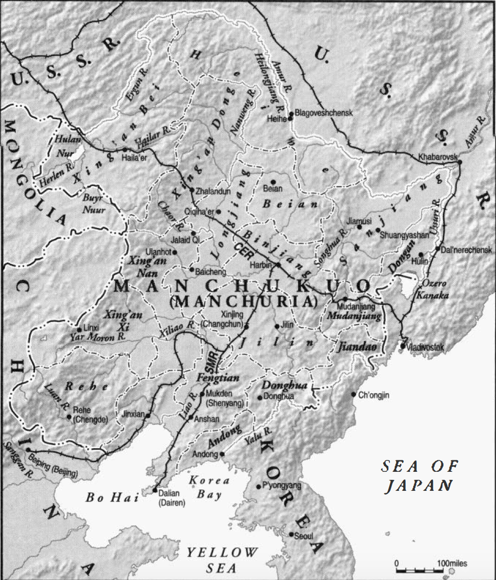
The Geopolitical Issue of Manchuria: Scope
Russia
19th -20th Century: A contested borderland where China, Russia, and Japan were the main competitors;
A liminal and indeterminate historical space being characterized by warfare, but also by opportunities for local elites who are able to play off one outside power against another;
China Proper
Japan

Slide 3
The Geopolitical Issue of Manchuria: Historical Overview
Qing Period (1644-1912)
Formation of the concept of “Manchuria” as a distinctive region;
Qing Frontier Policy: Ensuring the distinctive environmental (forests), socio-economic (ginseng, mushroom, and fur trade), and cultural (language and customs) features of this region;
Late Nineteenth Century: Increasing Degree of Sinicization
Triggers: Famine in north China; Expansions of Russia and Japan;
Lift of the ban on immigration into this region from China Proper
Population:
1787: 150,000
1907: 1.5 million, 81,000 were non-Chinese;

Slide 4
The Geopolitical Issue of Manchuria: Russia and Japan
Russia
Japan
1895 Treaty of Shimonoseki, Japan demanded to cede the Liaodong Peninsula;
1897 Built and maintained military & territorial control over the Chinese Eastern Railroad;
1900, After the Boxers, Controlled the entire Manchuria;
1905, The Treaty of Portsmouth : Lease on the Guandong Peninsula and the South Manchurian Road;
1915, 21 Demands, Privileged economic rights in southern Manchuria and eastern Inner Mongolia;
1903-1927 Economic Expansion:
Coal and iron mines, electric supply, railways, etc.
Manchurian share of Chinese foreign trade went from 3.5 to 32.5 percent, chiefly with Japan;
By 1927, 85 percent of the Japanese investment was in China, 80 percent of this was in Manchuria

Slide 5
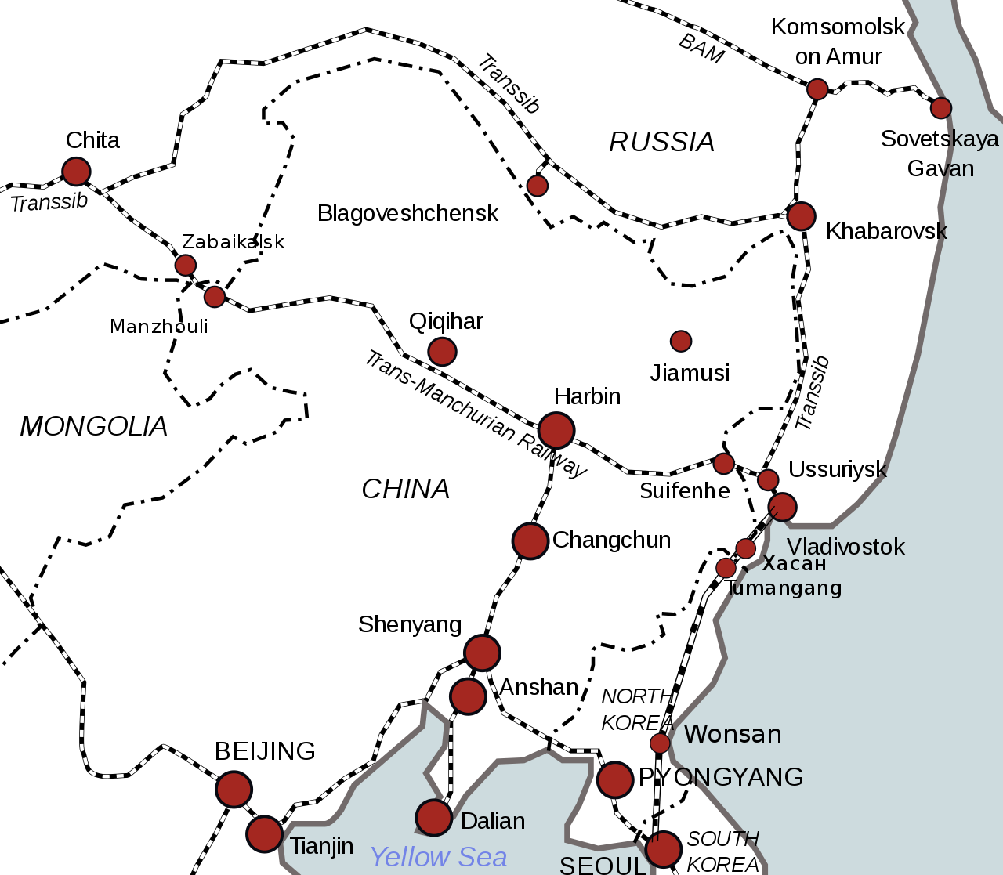
The Geopolitical Issue of Manchuria
CER
SMR
1928 Nationalist Government
Liaodong/Guandong Peninsula

Slide 6
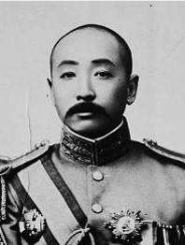
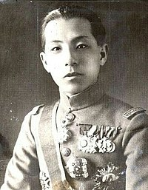
The Geopolitical Issue of Manchuria: The Mukden Incident
Borderland Politics before 1928:
Zhang Zuolin (1875-1928): sided with different countries at different times;
1911-1928 Cooperation between Zhang and Japan;
1920s Gradual Independence of Zhang from Japanese Influence: 1) Zhang’s ambition at the position in Beijing; 2) Built up core civilian support in the Mukden clique;
1928 Japanese feared Zhang’s increasing military involvement south of the Great Wall; Assassination of Zhang;
The Nationalist Turn after 1928:
Zhang Xueliang (1901-2001) succeeded his father and declared his allegiance to the GMD of a unified China;
1930 Extended his base into North China;
Railway Rights: Tried to take over the CER; Built and expanded railway lines to compete with the SMR;
Denial of landownership to Japanese nationals;

Slide 7
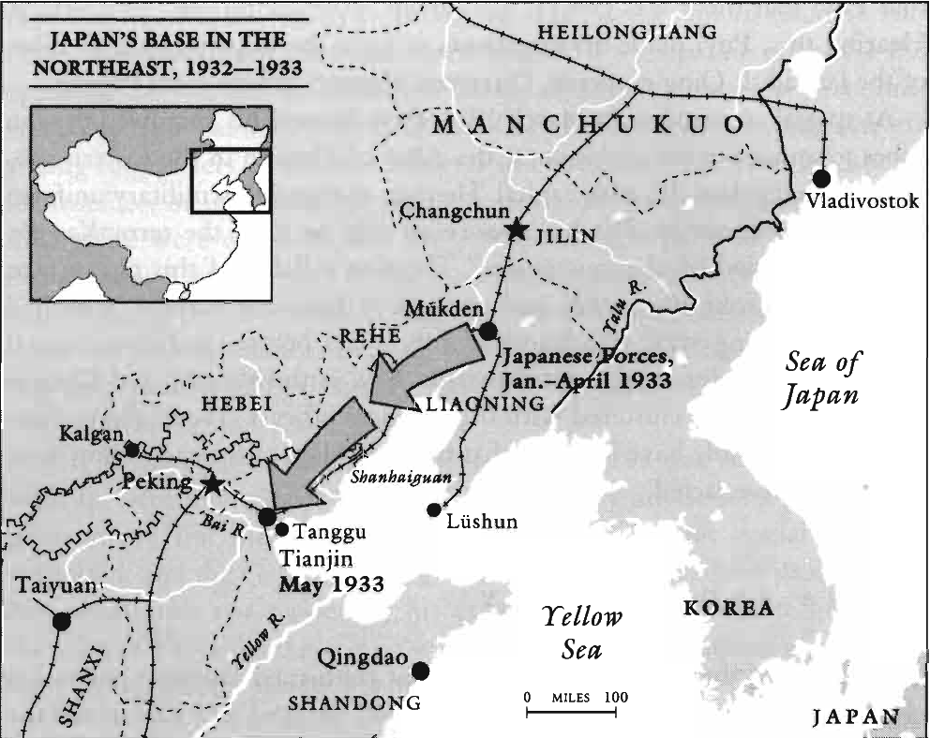
The Geopolitical Issue of Manchuria: The Mukden Incident
The Mukden Incident:
September 18, 1931, the Guandong Army set a bomb on an SMR line near Mukden;
Jiang Jieshi ordered Zhang Xueliang to withdrawal;
1932 Japan occupied all of the Manchuria; establishment of the independent Republic of Manchukuo;
The Manchukuo:
Puppet State: Puyi as the “chief executive;” The real power belonged to Japan;
Military Regime: Guandong army was the dominant army;
A Modern Developmental State: 1) development of an industrial base; 2) unified currency; 3) banking system;
A Brutal Regime: 1) monopolistic nature of the industrialization; 2) agricultural exploitation; 3) germ warfare experimentation;

Slide 8
International Reactions to the Manchuria Issue
Initial Attempts of the League of Nations:
U.S. actively proposed to internationalize the Manchuria Issue;
1931 The British Statesmen Lord Lytton ordered a commission to investigate the situations in Manchuria; The Lytton Report;
General Attitude: Solve the Manchuria crisis within the framework of international collaboration and without alienating Japan;
1932 Henry Stimson proposed to Britain to join together in condemning Japanese acts; Britain did not respond;
1933 The Breakdown of the International Framework:
Japan was unlikely to resume its responsible and peaceful position;
Global Trends to economic regionalism;
1933 Adjustment of American Foreign Policy: to prevent war through direct negotiations with individual counties, rather than through the League of Nations;
The Soviet Union: Avoid premature clashed with Japan

Slide 9
Responses of the Nationalist Government: Conceptualizations of World Order in the 1920s and 1930s
The “Imperialism” Framework: Since the mid-19th Century
A system at diplomatic balance;
Implication: competition and rivalry among the imperialist powers could be manipulated for China’s benefit;
Perception of the New World Order in the 1920s and 1930s: Hope for the International Approach:
The economic interests of the Anglo-American powers and Japan were incompatible; War between Japan and the Anglo-American powers were inevitable;
War between Soviet Union and Japan was also inevitable because of ideological and geopolitical reasons;
Chance for China to achieve international alliances against Japanese expansion;

Slide 10
Responses of the Nationalist Government: Negotiations with Japan, 1933-1934
After 1933, The Gradualist Approach: Appease Japan while eradicating military-regional rival regimes;
1934 Preparation for a Settlement with Japan on the basis of status quo:
Negotiations: mail and railway systems, tariff revision, debt settlement;
China accepted the existence of Manchukuo as a separate entity;
Japan pledged not to undertake further territorial acquisition southward;

Slide 11
Gradual Preparation for the War: Reversal of the Japanese Policy, 1935-1937
1935-1937 Reversal of the Japanese Policy
General Doihara Kenji undermined the incipient structure of Chinese-Japanese accommodations;
New Policies: 1) Separate North China; 2) Remove GMD influences; 3) Establish provisional regimes controlled by Japanese forces;
Secret Preparations of the Nationalist Government:
Military Affairs Commission: fortification plans for six cities in the lower Yangzi Region;
Constructions of batteries and other military facilities along the Yangzi River;
Plan to control the western provinces of Guizhou and Sichuan

Slide 12
Gradual Preparation for the War: Potential Alliances
The Nationalist Government and Soviet Union:
1934 Preliminary Contacts: potential alliances against Japan;
1935 Negotiations between Jiang Jieshi and the Soviet Ambassador Domitiri Bogomolov;
The Nationalist Government and CCP:
1936 Negotiations between Chen Lifu (GMD) and Zhou Enlai (CCP): 1) cooperation against Japan; 2) reorganization of the red armies; 3) future alliance with the Soviet Union;
After November, GMD position hardened—deadlock situation of the ongoing negotiations;
1936 The Xi’an Incident
Zhang Xueliang captured Jiang Jieshi and forced him to abandon the anticommunist campaigns and take an anti-Japanese stand;
Prelude to the full-scale allied fight against the Japanese;

