Slide 1
Scientific Method & Research Discussion
King’s College
Core273

Slide 2
What is the purpose of research?
Research: systematic investigation into and study of materials and sources in order to establish facts and reach new conclusions.
Conducted for exploration, to describe, or to explain.
Can be directed or non-directed.
Three common types:
Pure research: conducted to find out something unknown by examining anything.
Original research: looking for information no one else has found.
Secondary research: finding out what others have discovered trying to reconcile conflicts, find new relationships, arrive at own conclusions.

Slide 3
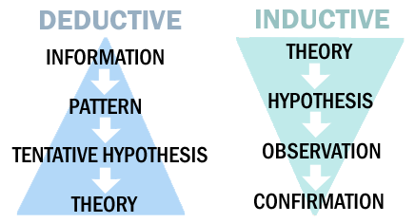
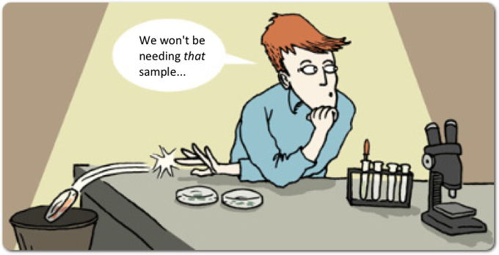
Characteristics of research
Systematic: rules and procedures to ensure objectivity.
Logical: cycle of deductive and inductive reasoning.
Deductive: involves reasoning from general to specific.
Inductive: reasoning from specific to general.
Empirical: derived from observations of what exists.
Replicable: can be repeated with similar results in similar circumstances each time.
Transmittable: should be representative of a larger population.
Reductive: focused on a manageable piece.
Objective: removal of personal values and bias – suspension of belief.

Slide 4
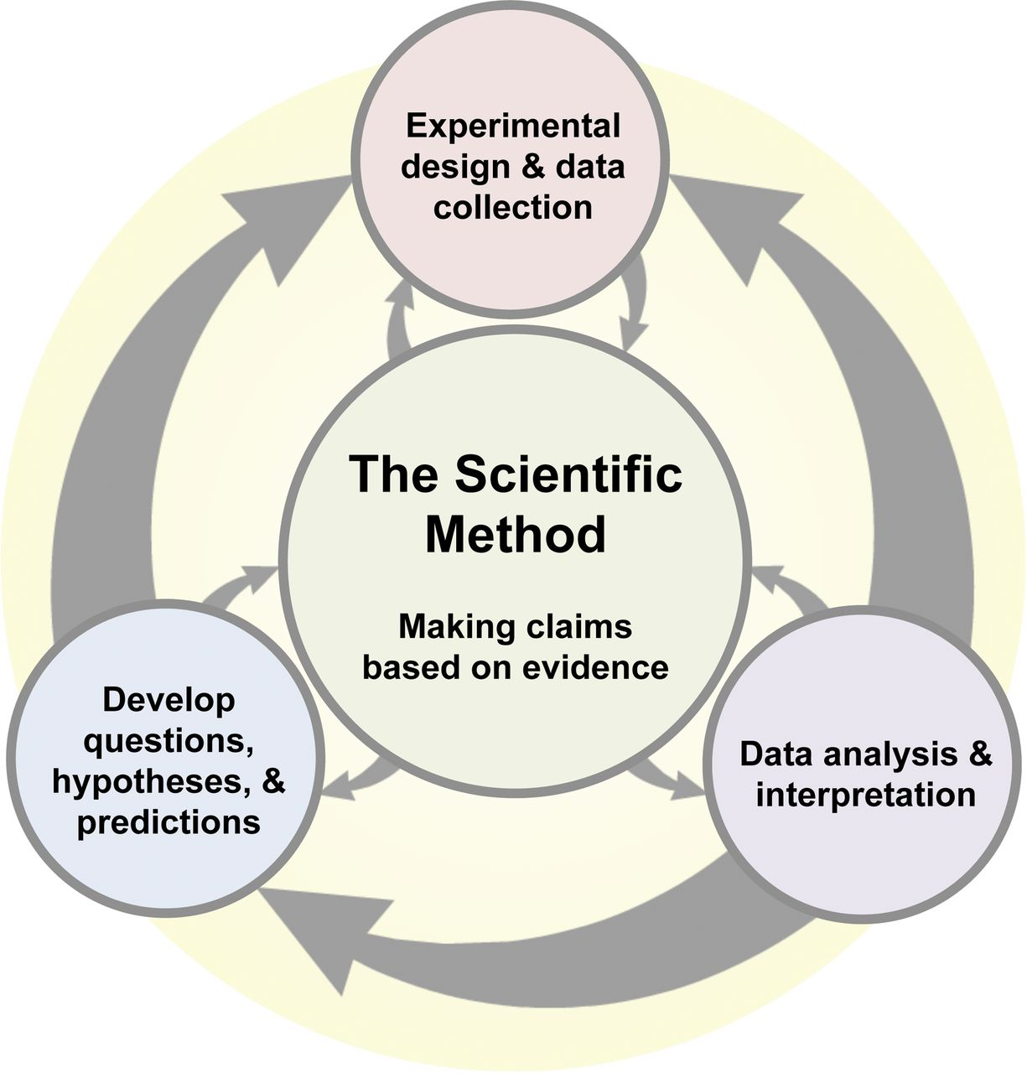
How should research be conducted?
The Scientific Method: “process by which scientists, collectively and over time, endeavor to construct an accurate (that is; reliable, consistent, and non-arbitrary) representation of the world”.
Observation and description of phenomenon.
Formulation of a hypothesis to explain phenomena.
An educated guess.
“Proposed explanation made of the basis of limited evidence as a starting point for further observation.”
Use of the hypothesis to make testable predictions.
Perform experimental tests/observations of the predictions and gather the appropriate data.
Accept or reject/modify the hypothesis AND REPEAT!

Slide 5
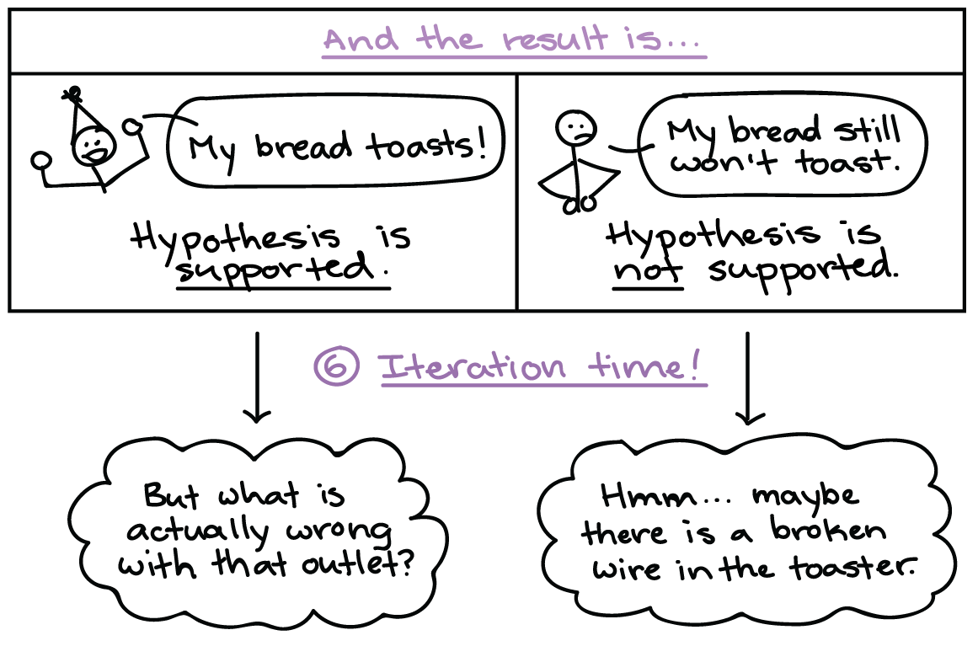
Experiments should be controlled
Determine variables: factors that can change.
Independent: goes unchanged by other variables; manipulated by experimenter.
Dependent: changes due to the independent variable.
Confounding: unintentional changes to dependent or independent variables.
Randomly select a large group of appropriate subjects.
Create two groups; similar in all ways except independent variable.
Experimental: receives variable to be tested.
Control: receives placebo or replaced/absent variable.
Conduct experiment.
Collect detailed and appropriate data and measurements.
Analyze collected data.
Make conclusions, modify, and repeat.
Elevation (independent) and boiling temperatures of water (dependent)

Slide 6
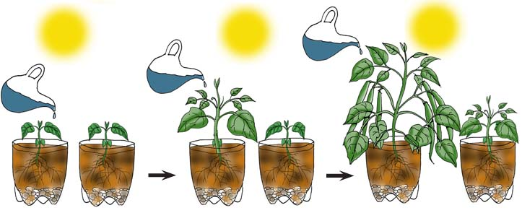
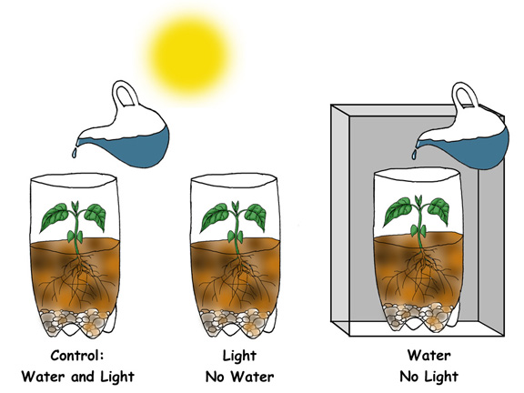
Two samples, one is the control group and the other is the experimental group.
Three samples. One is the control group and the other two are part of the experimental group.

Slide 7
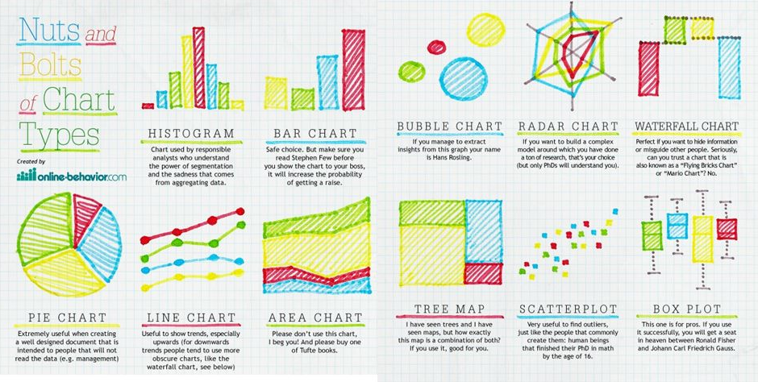
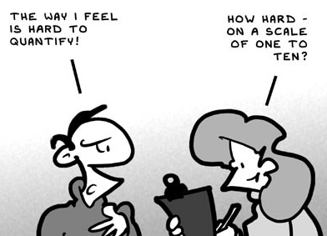
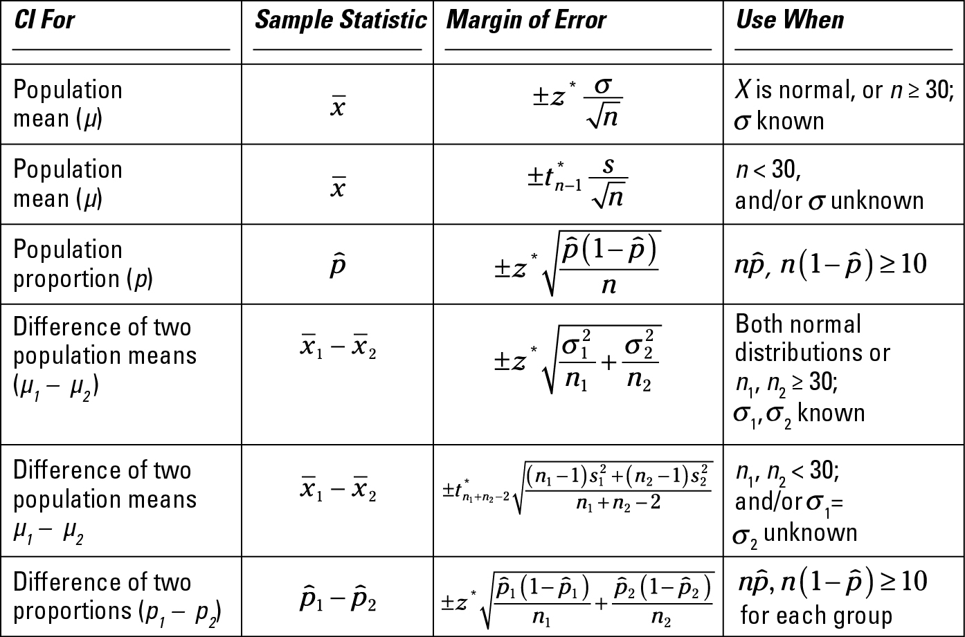
Data Types
Quantitative Data: collected data are numbers and statistics.
Information will commonly be displayed in graphs and tables.
Statistics will help determine the significance of the data.
Qualitative Data: collected data are words, pictures, or objects.
Data displayed in varying manners depending on methods used.

Slide 8
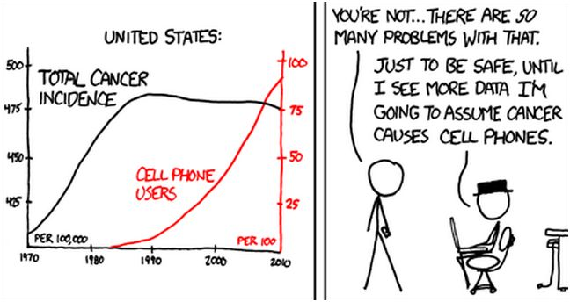
Interpreting data
Results can determine relationships between variables:
Correlation: two variables are closely related.
Causation: one variable causes another to occur.
Can you accept the hypothesis?
Does the data support what you thought?
Can you modify the hypothesis or experiment?
Could you make a better “guess”?
Could your experimental design be more solid?
Are there confounding variables? Bias?
Should you fully reject your hypothesis?
Not right away! Repeat and see what happens!

Slide 9
What do we do with what we find?
Hypothesis becoming a theory; NOT IMMEDIATE!
“ The process of establishing a new scientific theory is necessarily a grueling one; new theories must survive an adverse gauntlet of…experts in their particular area of science; the original theory may then need to be revised to satisfy those objections. The typical way in which new scientific ideas are debated are through refereed scientific journals…before a new theory can be officially proposed to the scientific community, it must be well-written, documented, and submitted to an appropriate scientific journal for publication. If the editors of these prestigious publications accept a research article for publication, they are signaling that the proposed theory has enough merit to be seriously debated and scrutinized closely by experts in that particular field of science”.
It is vital to disseminate research; to spread or disperse.
Peer-reviewed Journals: collection of articles analyzed and critiqued by appropriate peers. Contain the most accurate information.

Slide 10
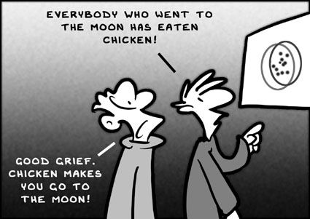
How do I read a research article?
Become a skeptic.
Appreciate the value of statistics.
Learn to read graphs.
Distinguish anecdotes from scientific evidence.
Anecdotes are testimonial and unverified.
Separate facts from conclusions.
Fact is objective reality.
Conclusion: judgement reached by reasoning.
Correlation versus causation.
Know that science has its limits!

Slide 11
Research and the Human Body
Knowledge of Anatomy (form)
Egyptian mummification (BC 1600-1550).
Herophilus and Erasistratus perform systemic cadaver dissections (3rd century).
Discontinued in Middle Ages, revived in Renaissance (12th century onward).
Andreas Vesalius published De Humani Corporis Fabrica (16th century).
Knowledge of Physiology (function)
Erasistratus “Father of Physiology” applied physical laws to human function.
William Harvey demonstrated heart pumps blood through vessels (1578-1657).
Anton van Leeuwenhoek 1st man to make and use real microscope (1632-1723).
Majority of our knowledge has been gained in the 20th century.
Many early experiments had no ethical boundaries.

Slide 12
Ethics in human research
“The whole discipline of biomedical ethics rises from the ashes of the Holocaust” (Robert Leiter, Tainted Science, Jewish World, July 14-20, 1989).
The Nuremberg Code (1947) establishes principles to guide physicians in human experimentation.
http://www.cirp.org/library/ethics/nuremberg/
When human subjects can not be ethically elected, animals are often used.

Slide 13
DISEASE | DISCOVERY
Heart Disease | Studied in dogs, rats, rabbits, cats, sheep, and pigs. Studies with dogs contributed to our most basic understanding of how to manage heart disease. Techniques to diagnose the workings of the heart—electrocardiography, cardiac catheters, angiograms, and coronary blood flow measurement—were developed through research using dogs, as were surgical techniques such as cardiac bypass, angioplasty, and heart transplants
HIV/AIDS | Our understanding of the retrovirus that causes HIV/AIDS comes in part from studies of similar viruses in chickens, cats, and monkeys. Promising drugs and possible vaccines are tested first in mice and monkeys before being used in clinical trials with human volunteers.
Cancer | The chicken provided one of the earliest models of how cancer grows and spreads. An understanding of how viruses cause tumors and the use of hormone treatments to limit tumor growth were developed using rats, mice, rabbits, chickens, monkeys, and horses. Cancer treatments such as chemotherapy drugs, radiation therapy, and various surgical techniques were developed using rodents, dogs, and monkeys, among others.
Bacterial Infections | The effectiveness of penicillin and other antibiotics as treatments for bacterial infections was established through research using mice and other rodents. Scientists continue to use animals to determine what antibiotics are effective against specific organisms, their toxicity, and their potential side effects.

Slide 14
Why do I need to know this, here?
Yes, the form and function of the human body is pretty well understood, BUT:
Sometimes things go wrong!
Disease ravages the body, medications become obsolete (think “antibiotic resistance”).
What we have now could be better!
Technology could make surgery less invasive, treatments more effective.
As living things, humans can adapt and evolve.
ASPM is a brain size regulator of increasing levels in younger individuals.
Sometimes we learn that we just weren’t “right” to begin with.

Slide 15
SOURCES
https://labwrite.nscu.edu/instructors/scientificart-parts.pdf
http://public.wsu.edu/~taflinge/research.html
http://www.academia.edu/3488108/The_General_Purpose_and_Charecteristics_of_Research_With_Hamalambo_Kanini_LWSC_and_Lusaka_University
http://teacher.nsrl.rochester.edu/phy_labs/AppendixE/AppendixE.html
http://www.lib.vt.edu/research/methodology/quantitative-qualitative.html
http://infohost.nmt.edu/~klathrop/controlled_experimnet.pdf
http://www.oakton.edu/user/4/billtong/eas100/scientificmethod.htm
https://www.ncbi.nlm.nih.gov/pmc/articles/PMC4582158/pdf/acb-48-153.pdf
http://sbw.kgi.edu/sbwwiki/_media/sysbio/labmembers/hsauro/304_2009/origin_of_physiology2.pdf
http://www.history-of-the-microscope.org/history-of-the-microscope-who-invented-the-microscope.php
http://www.qcc.cuny.edu/SocialSciences/ppecorino/MEDICAL_ETHICS_TEXT/Chapter_7_Human_Experimentation/Reading-Nazi-experimentation.htm
http://www.the-aps.org/mm/SciencePolicy/AnimalResearch/Publications/animals/quest1.html – citation for table.
http://metrc.smu.edu.cn:81/userfiles/files/SpecialistLibrary/EnglishFulltext/%E8%93%9D%E7%94%B0%EF%BC%88%E5%90%8D%E5%B8%88%EF%BC%89/Ongoing%20adaptive%20evolution%20of%20ASPM,%20a%20brain%20size%20determinant%20in%20Homo%20sapiens.pdf

