Slide 1
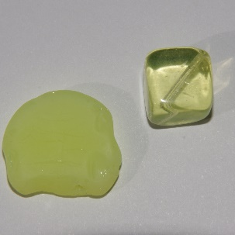
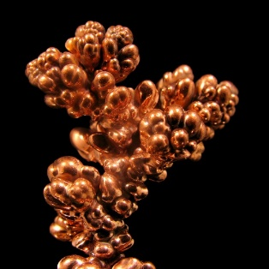
Individual Projects/Supply Chain Processes
Lithium
Brazil
www.Free.SourceMap.Com
Supply Chain Process #1.
Describe three of the resources needed to produce the product. Procure at least one source from overseas.
The diagram would include three boxes with the resource and the location such as this example.
Write an APA format paper of one page no more than two about the supply.
Recommend using PowerPoint and copying into MS Word for the final presentation, but this assignment can use an MS Word diagram. See chapter 1.
Glass
Europe
Aluminum
Australia

