Slide 1
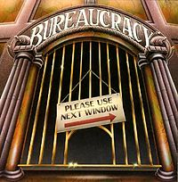
Bureaucracy in a Democracy
.

Slide 2
Bureaucracy and Bureaucrats
Bureaucracy: the complex structure of offices, tasks, rules and principles of organization that are employed by all large-scale institutions to coordinate the work of their personnel.
Rule by desk and offices.

Slide 3
TERMS:
IMPLEMENTATION: THE EFFORTS OF DEPARTMENTS AND AGENCIES TO TRANSLATE LAWS INTO SPECIFIC BUREAUCRATIC RULES AND ACTIONS
Congress makes the laws, but doesn’t really explain how to carry them out. Hence the need of bureaucracies to be given guidance.
Making Rules
The process of making rules is highly political, even when based on science.
Agencies must submit rules to the public in advance to obtain feedback during a comments period.
This is where lobbyists and other special interests play a big role.
MERIT SYSTEM: APPOINTEES TO POSITIONS IN PUBLIC BUREAUCRACIES MUST OBJECTIVELY BE DEEMD QUALIFIED FOR THOSE POSITIONS

Slide 4
DEPARTMENT: THE LARGEST SUBUNIT OF THE EXECUTIVE BRANCH; 15 DEPARTMENTS FORM THE PRESIDENT’S CABINET
INDEPENDENT AGENCY: AGENCY THAT IS NOT PART OF A CABINET DEPARTMENT.
-Set up by Congress, appointed and directed by President
-They provide important public services; examples: NASA, EPA.
GOVERNMENT CORPORATION: GOVERNMENT AGENCY THAT PERFOMRS A MARKET-ORIENTED PUBLIC SERVICE AND RAISES REVENUES TO FUND ITS ACTIVITIES.
REGULATORY AGENCY: DEPARTMENT, BUREAU, OR INDEPENDENT AGENCY GIVEN DISCRETION BY CONGRESS TO MAKE RULES AND REGULATIONS, IMPOSE LIMITS AND RESTRICTIONS ON THE CONDUCT OF INDIVIDUALS OR COMPAINES IN THE PRIVATE SECTOR.
-Example: FDA; EPA, SEC, ETC…

Slide 5
FISCAL POLICY: THE GOVERNMENT’S USE OF TAXING, MONETARY, AND SPENDING POWERS TO MANIPULATE THE ECONOMY.
FEDERAL RESERVE SYSTEM: SYSTEM OF 12 FEDERAL RESERVE BANKS THAT FACILITATES EXCHANGES OF CASH, CHECKS, AND CREDIT; REGULATES MEMBER BANKS; AND USES MONETARY POLICIES TO FIGHT INFLATION AND DEFLATION.
REVENUE AGENCY: AN AGENCY RESPONSIBLE FOR COLLECTING TAXES.
Example: IRS, US Customs, ATF, etc…

Slide 6
OVERSIGHT: THE EFFORT BY CONGRESS, THROUGH HEARINGS, INVESTIGATIONS, AND OTHER TECHNIQUES, TO EXERCISE CONTROL OVER THE ACTIVITIES OF EXECUTIVE AGENCIES.
-An expressed power Congress has in the Constitution.
-Congress’ way of making sure Executive does job right.
-May call a hearing on any Executive Agencies.
-Example: head of CIA may be called to testify to Congress, provide explanations on anything Congress wants.
-Every aspect of the Executive branch, with the exception of the President, is liable to oversight.
-The President is exempt, because he/she may claim Executive Privilege.

Slide 7
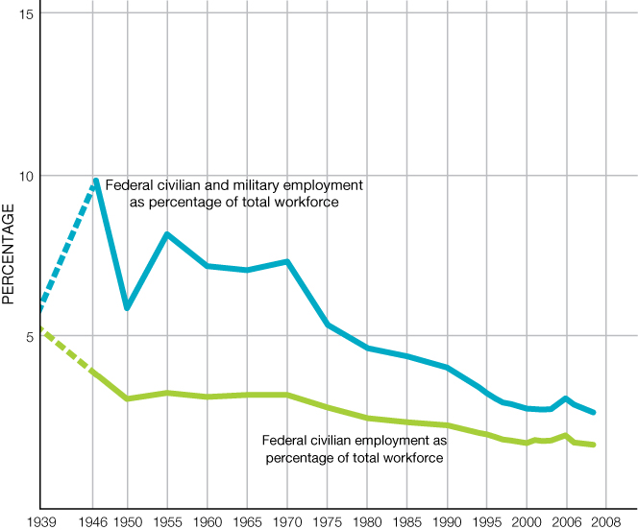
Bureaucracy and Bureaucrats
The Size of the Federal Service
America’s federal bureaucracy has shrunk in the last 35 years
1968: 3m civilians, 3.6m military
2008: 2.7m civilians, 1.4m military

Slide 8
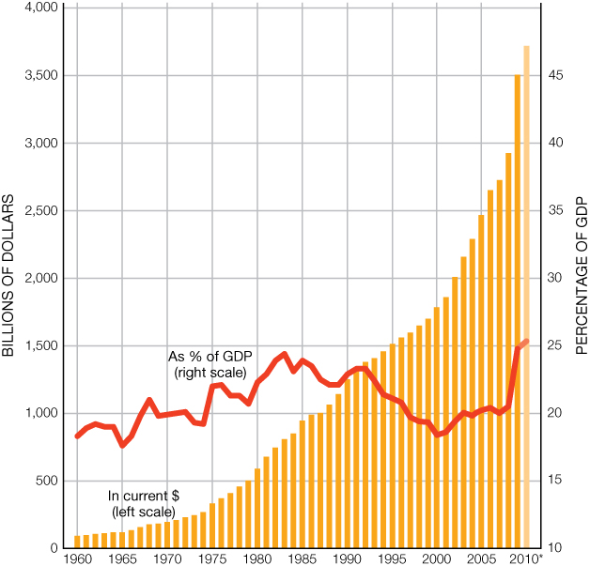
Bureaucracy and Bureaucrats
Despite population growth, spending as a percentage of GDP has remained remarkably constant

Slide 9
Bureaucracy and Bureaucrats
Federal Register: Once all the rules are decided on they are published in the Federal Register which gives them force of law.
It’s an actual journal published by the government that contains most routine publications and public notices of government agencies. It is a daily publication.
The Federal Register is a way for the government to think aloud to the people, and also serves as official journal of
record for the approved acts of the U.S. Government.
http://www.archives.gov/federal-register/

Slide 10
Bureaucracy and Bureaucrats
Enforcing Laws
Agency powers can include:
Demanding reports
Auditing books
Monitoring contracts
Tracking company obligations
Regulating citizen actions
Notes:
Asking students for examples is a good exercise here. They may be stumped at first, but someone should quickly come up with some action performed by the FDA, FCC, or EPA. You might want to note that weights and measures are regulated by the government (students may be familiar with the little stickers on gas pumps monitored by local governments).

Slide 11
Executive Branch Employees, 2010 (in thousands)
Key
> 0.6%
0.6 – 5.5%
5.6 – 10.5%
10.6 – 15.5%
15.5% +
Defense
28%
773
Veterans
Affairs
11%
305
Independent Agencies
9.5%
180
Homeland Security
6.6%
183
Interior
2.5%
70
Transportation
2.1%
58
Independent agencies include NASA, the EPA, and the Social Security Administration (shown here), as well as other agencies.
SOURCES: U.S. Census Bureau 2012 Statistical Abstract; Bureau of Labor Statistics.
Notes:
Contrary to popular notions of “paper pushers,” the people who work in the federal bureaucracy perform a range of tasks essential to the functioning of American society. Nearly 2 million executive branch employees are involved in protecting the nation’s security, managing the economy, and promoting public welfare through various means including environmental protection and health and safety regulations. Most federal employees work outside the Washington, D.C., area.

Slide 12
Executive Branch Employees, 2010 (in thousands)
Key
Health & Human Services
3.25%
70
> 0.6%
0.6 – 5.5%
5.6 – 10.5%
10.6 – 15.5%
15.5% +
Education
0.14%
4
Soc. Sec. Admin.
2.5%
70
Justice
4%
118
EPA
0.68%
19
Independent agencies include NASA, the EPA, and the Social Security Administration (shown here), as well as other agencies.
SOURCES: U.S. Census Bureau 2012 Statistical Abstract; Bureau of Labor Statistics.
Notes:
Contrary to popular notions of “paper pushers,” the people who work in the federal bureaucracy perform a range of tasks essential to the functioning of American society. Nearly 2 million executive branch employees are involved in protecting the nation’s security, managing the economy, and promoting public welfare through various means including environmental protection and health and safety regulations. Most federal employees work outside the Washington, D.C., area.

Slide 13
Executive Branch Employees, 2010 (in thousands)
Key
> 0.6%
0.6 – 5.5%
5.6 – 10.5%
10.6 – 15.5%
15.5% +
Treasury
4%
110
Commerce
2.10%
57
Agriculture
3.9%
107
NASA
0.7%
19
State
1.4%
39
General Services Admin
0.47%
13
Labor
0.65%
18
Energy
0.58%
16
Housing & Urban Dev.
0.36%
10
Independent agencies include NASA, the EPA, and the Social Security Administration (shown here), as well as other agencies.
SOURCES: U.S. Census Bureau 2012 Statistical Abstract; Bureau of Labor Statistics.
Notes:
Contrary to popular notions of “paper pushers,” the people who work in the federal bureaucracy perform a range of tasks essential to the functioning of American society. Nearly 2 million executive branch employees are involved in protecting the nation’s security, managing the economy, and promoting public welfare through various means including environmental protection and health and safety regulations. Most federal employees work outside the Washington, D.C., area.

Slide 14
Location, 2008
(number of federal employees in thousands)
Washington, D.C. Area
17%
320
83% – Other
1,589
Independent agencies include NASA, the EPA, and the Social Security Administration (shown here), as well as other agencies.
SOURCES: U.S. Census Bureau 2012 Statistical Abstract; Bureau of Labor Statistics.
Notes:
Contrary to popular notions of “paper pushers,” the people who work in the federal bureaucracy perform a range of tasks essential to the functioning of American society. Nearly 2 million executive branch employees are involved in protecting the nation’s security, managing the economy, and promoting public welfare through various means including environmental protection and health and safety regulations. Most federal employees work outside the Washington, D.C., area.
Questions for Classroom Discussion:
Which category of departments and agencies—security, economic, or public welfare—employs the most people? Why?
With 2 million people working for the executive branch, mostly outside of the Washington, D.C., area, how can Congress and the president be sure that they are serving the public’s interests?

Slide 15
Organization of the Executive Branch
Independent Agencies
Treated like any other bureaucratic agency, but exist outside the current departmental system. Usually have sweeping mandates
CIA, EPA, NASA
Government Corporations
Provide public services, and, while chartered by the U.S. government, are highly independent. Work like nonprofits.
Examples: Amtrak, United States Postal Service, Corporation for Public Broadcasting, Federal Deposit Insurance Corporation
Notes:
The EPA is so big that each president must decide whether to include the administrator in the cabinet.

Slide 16
Organization of the Executive Branch
Independent Regulatory Commission
Highly specialized rule-making bodies that are supposed to be insulated from politics. Can act without influence
Typically overseen by a board of commissioners appointed for fixed terms
Often they are formed and accorded power by Congress to regulate a specific industry. Within the authority granted them by Congress, they have the power to form and enforce their own regulations.
Examples: Federal Communications Commission, Federal Aviation Administration
Notes:
The Securities and Exchange Commission, for example, has five commissioners, not more than three of whom can be from the same political party. They serve 5-year terms, with one term expiring on June 5 of each year. These bodies are not expected to be apolitical, but are supposed to be somewhat insulated from fears of Congress interfering with their day-to-day work.

Slide 17
Read about all the different agencies
The whole middle portion of chapter 14 contains descriptions of many different departments and agencies in the government. Read that section and get a general idea of what the different agencies do.

Slide 18
Can the Bureaucracy be Reformed?
National Performance Review (1993) pledge by Clinton to make it more efficient. $136B saved
Termination of programs The only real way to decrease the size of the American Bureaucracy is cut programs.
Deregulation Getting rid of the rules. How did that work for the banking sector?
Devolution downsizing
Privatization move the services out of government hands. Why shouldn’t religions be in charge of taking care of the poor and needy?

Slide 19
Managing the Bureaucracy
The Managerial Presidency
Presidents have vast authority over budgeting
Nominate top officials in every department
Have tremendous influence over the policies agencies purpose and follow
Difficult to displace agency cultures; civil servants cannot be fired.
Why?
Apolitical. Sweeping firings. Government functions
Agency culture and the way money is dolled out. Tell army bullets story.
Notes:
It is also very difficult for high-level managers to have an impact if they are trying to impose dramatic changes not favored by the civil servants in their agencies. High level administrators and cabinet level secretaries stay on average a mere three years, which is a very short time period compared to civil servants who can remain in their positions for decades.

Slide 20
Managing the Bureaucracy
Congressional Oversight
Committees are expected to oversee the executive branch agencies in their purview
Often oversight is partisan
Can be effective in bringing issues to the public’s attention
Iron Triangles: members of Congress can be too supportive of agencies to be critical of them
Notes:
Presidential appointees can be terrified of Congressional inquiries, because they rely on Congress for budget appropriations. Yet this fear is often balanced by the knowledge that, in most cases, those very same committee members usually want to increase spending on their agencies, not decrease it, and they often have little say otherwise in what agencies do.

Slide 21
The Greatest State in the Union NEVADA!!!
Governor of Nevada is the chief magistrate of the U.S. state of Nevada, the head of the executive department of the state's government and the commander-in-chief of the state’s military forces.
The governor has a duty to enforce state laws
The power to either approve or veto bills passed by the Nevada Legislature
To convene the legislature at any time
Except in cases of treason or impeachment, to grant pardons and reprieves.
The governor has a four-year term.
To be elected governor, a person must be at least 25 years old, and must have been a citizen of Nevada for at least two years, at the time of election.
The lieutenant governor is not elected on the same ticket as the governor.

