Slide 1
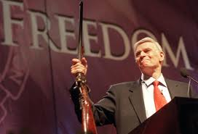
Chapter 11: Groups and Interest

Slide 2
The Character of Interest Groups
The Founders said:
People in a free society will always pursue their interests
The goal is to ensure they do not harm others in the process
Thus, the formation of interest groups is foregone conclusion in a democracy.
The concern, however, is to make sure that interest groups do not harm the health of the republic.
Notes:
This quotation comes from Federalist #10, where Publius argued in favor of the new national government by claiming that this government would make it more difficult for a permanent majority to form and tyrannize others.

Slide 3
Interest Groups
Interest Groups perform many functions:
Speak on behalf of members
Mobilize citizens
Keep citizens informed
Hold officials accountable
Litigate on behalf of individuals
Represent many varied interest:
Agriculture
Labor
Professionals
Ideology
And pretty much anything you can think of.
Notes:
A key point to drive home is that groups can do many things that citizens could not on their own. For example, they provide information to elected officials and provide expertise on complex issues when they speak on behalf of their members.

Slide 4
The Characteristics of Members
Group membership is biased towards those at the higher end of the socioeconomic spectrum
More time, money and expertise
More likely to be asked to join if you have high socioeconomic status
Higher sense of efficacy
Notes:
A helpful way to get students thinking about this are the lunch-time service groups found in every town. These are the signs at the town line announcing where the Lions or Rotary club meets on a given Tuesday. Those groups are composed of business people, who can take an hour and a half off for lunch—and at times expense it to their employers. Wage-earners can’t do that.

Slide 5
Free Rider Dilemma
How to attract members who will enjoy the collective benefits, whether they join or not. (Unions have to deal with this.) Why be a member when you can get the benefits without participation?
Selective benefits are used to encourage membership.
Informational: education
Material: Swag, perks
Solidarity: Getting to know people, making friends
Purposive: Being part of achieving the goals of the group.
Notes:
Use with the following slide.

Slide 6
Number of Interest Groups Keep Growing
The number of interest groups in America has grown exponentially over the last few decades
Expansion of government
To push for new government spending
To push for government regulation
To support new programs
To counter other groups
New politics of interest groups
Generation of activists who came of age protesting civil rights violations and Vietnam
Tremendous sense of efficacy
See groups as a central mechanism for political change
Use new communications technologies
Notes:
Now, nearly every profession, industry, financial interest, and hobby is represented. For nice tables on this, see Jonathan Rauch, Government’s End.

Slide 7
Public Interest Groups (also known as Citizen Groups:
Groups that claim to act on behalf of the general good as opposed to the material interests of the members.
Notes:
Students will almost certainly be familiar with PIRG, and you may want to ask them for examples of other Public Interest Groups. You may also explain that the government facilitates public interest law firms that litigate on behalf of the people and that can reclaim expenses when they win lawsuits against companies for violating the law. They have a serious impact in litigating against manufacturers and natural resource extractors that harm the environment. For more on this, see Richard A. Harris and Sidney M. Milkis, The Politics of Regulatory Change.

Slide 8
Lobbying
Lobbying Defined
Direct lobbying is lobbying that entails face to face contact with public officials.
Informal direct lobbying entails contact with policymakers outside formal governmental processes.
Indirect lobbying is aimed at citizens rather than public officials.

Slide 9
What exactly do they do?
Direct Lobbying
Lobbying: a strategy by which organized interests seek to influence the passage of legislation by exerting direct pressure on government officials.
Also, an attempt by a group to influence the policy process through persuasion of public officials
Effective Lobbyists:
Have access to members of Congress
Lot of lobbyists former members of Congress
Or, former high-level staffers
Raise money in return for access
Have information
Represent very knowledgeable groups or constituents
Notes:
There are currently 34,000 registered lobbyists. A point to make is that citizens can go to members of Congress on their own and do not have to register. Even if individuals were to go on behalf of an organization, they would not be considered lobbyists unless they took any compensation for the visit, including travel expenses.

Slide 10
What good are they?
Lobbyists can cooperate to generate campaigns
Grassroots support
Fundraising
Media efforts
Lobbying members of Congress
Members of Congress can go to lobbyists to help gain support
Also: Organize Direct Action, Strikes, Boycotts, Letter Writing Campaigns, Sponsorship Activities.
Notes:
The world of lobbying is often one of different groups working together. Different groups quite frequently join forces, especially when some have very strong relationships with certain members and other groups have relationships with other members.

Slide 11
Providing Information
The Provision of Information
The essence of lobbying is the provision of information to policy makers.
The art of lobbying then is being in a position to communicate this information.
Lobbyists seek to provide three types of information:
Policy analysis.
Political analysis.
Legal analysis.

Slide 12
Going Public: attempting to generate the widest and most positive public opinion about an issue
Institutional advertising (advertising designed to create a positive image of an organization)
Organizing protests and demonstrations
Getting members to petition Congress directly

Slide 13
Keeping Lobbying Ethical
Obama administration bans all lobbyists from being hired for one year (a few exceptions have been made)
All lobbyists must register as lobbyists.
Businesses and trade associations cannot write off lobbying expenses
More disclosure rules
Lobbyists cannot give personal gifts over $50 in value
Notes:
Unfortunately, many of the disclosure rules have been circumvented by groups no longer classifying themselves as lobbyists. They do so by creating a different corporate entity that conducts their lobbying affairs.

Slide 14
What’s bad about them?
Can facilitate corruption.
Can facilitate things that seem to be obviously corrupt, but are really perfectly legal.
Can prevent solutions.
Interest group can become more important than the interest they serve.
Create lazy politicians.
Can become part of the government thus destroying pluralism and competition.

Slide 15
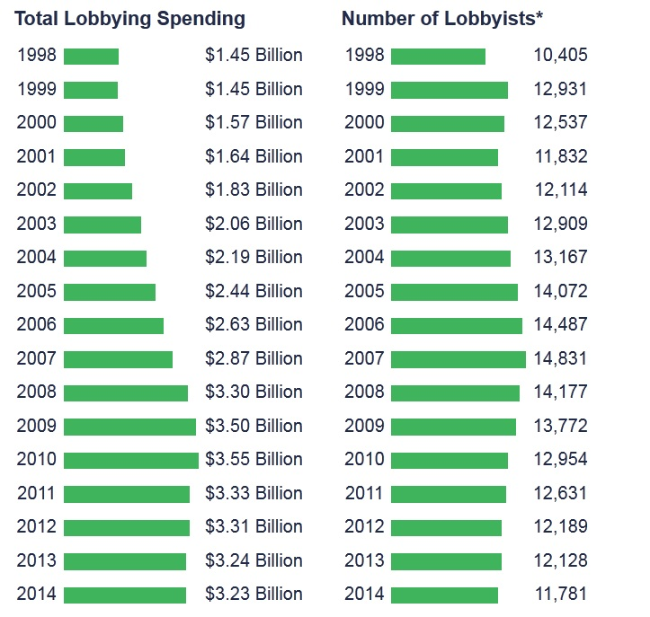
https://www.opensecrets.org/lobby/

Slide 16
A Corrupting Influence?
Strong correlations exists between interest group money and roll call votes, but is it causal?
Interest groups side more with politicians that they’ve worked with, while opposing those who they have a bad track record with.
Interest groups that are ideological usually work with lawmakers that have similar ideologies.
Interest groups that represent business interests work with everyone, since they don’t care for ideology.

Slide 17
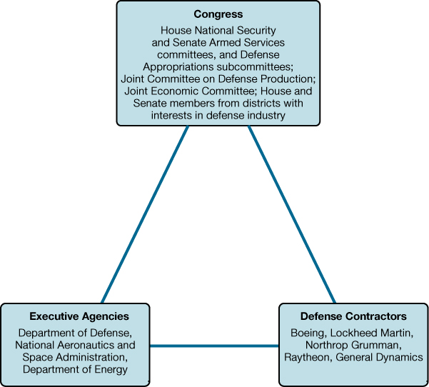
The Iron Triangle
Members of Congress get on committees that will help their constituents. This often means supporting businesses instead of regulating them.
Notes:
FIGURE 11.2 The Iron Triangle in the Defense Sector
Defense contractors are powerful actors in shaping defense policy; they act in concert with defense committees and subcommittees in Congress and executive agencies concerned with defense.

Slide 18
Lobbying with Money
When does money “buy” votes?
Are all Votes Equal?
Size of the majority coalition.
Issue saliency and the public.
Party leaders.
Caucus leaders.
Maintaining the status quo.
Not buying votes, but keeping the right voters in place.

Slide 19
What Does Money Buy?
The Provision of Private Goods
Most commonly seen in outsourcing
Corporate lobbyists are less likely to ask for votes than they are to ask for help in obtaining private goods such as contracts, regulatory waivers, and subsidies.
The number of legislators needed to provide private goods is much less than compared to the number needed to provide collective goods.
The amount of private goods that government provides have increased dramatically.

Slide 20
Lobbyists and interest groups today are far more powerful than they have ever been.
With no limitation on private spending when it comes to politics, interest groups have attained more influence.
Between political polarization in the country, and the increased role that money plays in politics, interest groups keep growing powerful by the day.
What does this say about the voice of the single voter in a democracy???

