Slide 1
ITS 835 enterprise risk management Chapter 6
Strategic Risk Management at the LEGO Group

Slide 2
introduction
LEGO Group history
Strategy
Legacy risk management
Enterprise risk management at LEGO
Initial ERM
Monte Carlo simulation
Active Risk Assessment of Business Projects (AROP)
Preparing for Uncertainty
The PAPA model
Risk management ROI

Slide 3
Lego group history
Headquarters in Billund, Denmark
Family owned
Second largest toy manufacturer (globally)
Founded in 1932
Iconic bricks first introduced
Bricks manufactured since 1958 fit with one another
2400 different brick shapes
Manufactured in plants across four countries

Slide 4
Lego strategy
LEGO mission
“Inspire and develop the builders of tomorrow”
LEGO vision
“Inventing the future of play”
Growth strategy
Innovation strategy

Slide 5
ERM at lego
Risk management developed in 4 stages
Step 1: Enterprise risk management
Step 2: Monte Carlo simulations
Step 3: Active Risk & Opportunity Planning (AROP)
Step 4: Preparing for Uncertainty
Order is by initiation sequence
Steps 1 & 2 are damage control
Steps 3 & 4 are proactive

Slide 6
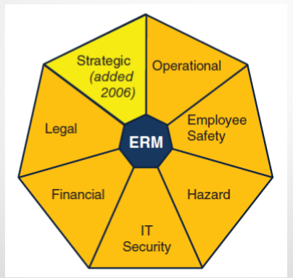
Erm Step 1: enterprise risk management

Slide 7
ERM Step 2: Monte Carlo Simulations
Monte Carlo simulation
Method of evaluating the effect of input variances on a model of a complex system
In short, it helps to see how input variances affect outcomes
Helps to define risk tolerance
Implemented in three areas
Budget simulation
Credit risk portfolio
Consolidation of risk exposure

Slide 8
Erm step 3: arop
Active Risk Assessment of Business Projects (AROP)
Formal approach to defining and handling project risk
Includes multiple steps
Identification
Assessment
Handling
Reassessment
Follow-up
Reporting

Slide 9
Erm step 4: preparing for uncertainity
Preparing for Uncertainty
Defining and Testing Strategies
Workshops precede strategic planning sessions
Four scenarios
Agree on two key drivers of uncertainty
Describe each of four quadrants of 2x2 matrix
Define strategic issues
Actions to take
“who is doing what by when?”

Slide 10
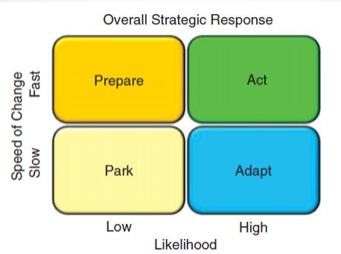
The papa model
Park, Adapt, Prepare, Act: PAPA
Park
Adapt
Prepare
Act

Slide 11
Risk management roi
Strong support from upper management
Efforts have resulted in value
Many LEGO key planning processes now include risk management
More visibility of enterprise risk
More opportunity to address risk

Slide 12
summary
Risk management is not risk aversion
ERM allows LEGO to take risks when appropriate
Grow
Create value
LEGO strategic risk management mission
“Drive conscious choices”

