Slide 1
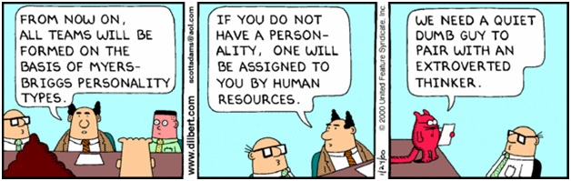
Chapter 3: Personality, Perception and Attribution

Slide 2
Learning Objectives
Recognize and describe traits and personality characteristics
Contrast personality dimensions using proper wording
Explain factors influencing perception
Recognize major perceptual and attribution biases and raise self-awareness on own biases
Understand Emotional Intelligence components and begin application through increasing self-awareness

Slide 3
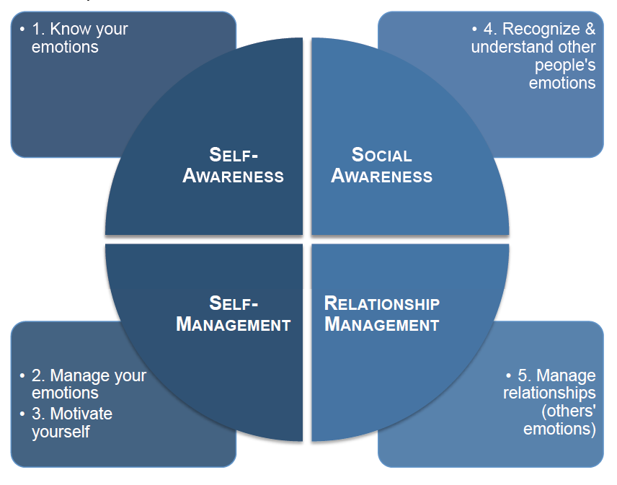
EQ

Slide 4
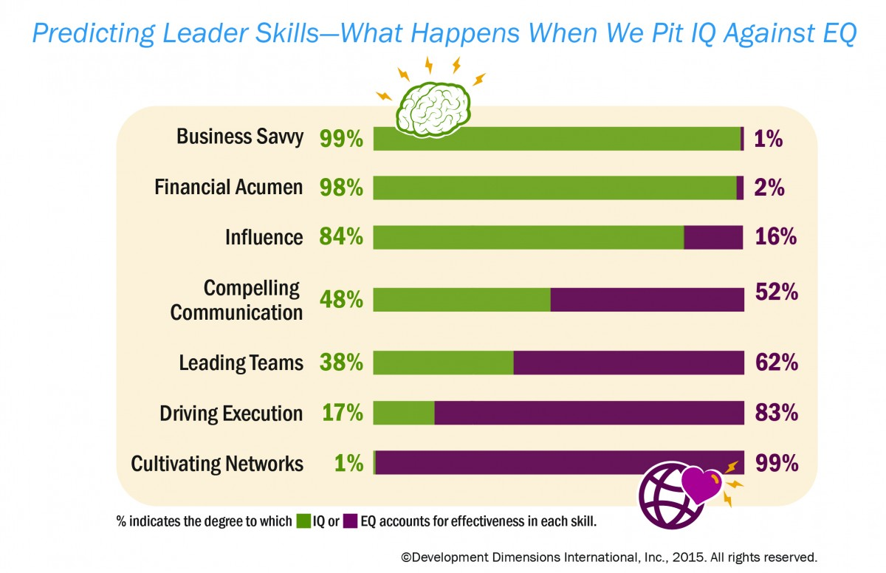

Slide 5
EQ: Team work
Pick a situation or event, involving an interaction with another person, in which you have not reacted in the most productive manner.
Think individually 5 min.
Discuss with peers 15 min.
  What can you specifically identify as self-awareness? Social awareness?
  Describe an application of self-management.
  Describe your relationship management.
2 team members report out for each team + Q&A
1 in each team writes down 3-5 bullet points on each story

Slide 6
Personality
Relatively stable set of characteristics that influences an individual’s behavior and lend it consistency
Probable origins
  Heredity
  Environmental factors
    Family, cultural, and educational influences
    Informed and influenced by situations
    No “good” or “bad” personality types. All have strengths.

Slide 7
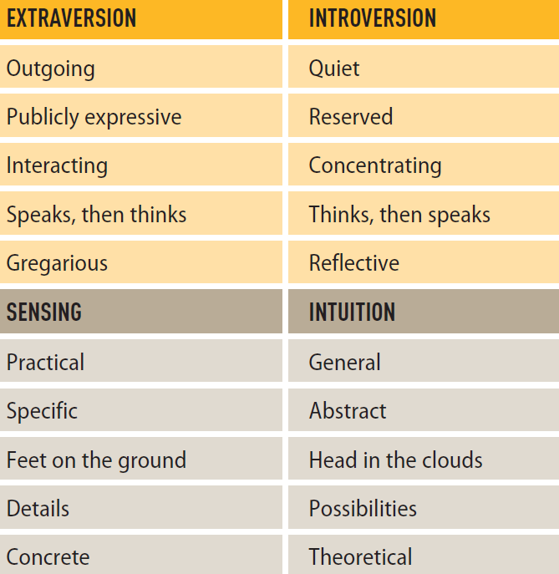
MBTI Types - Preferences
Energy
Information gathering

Slide 8
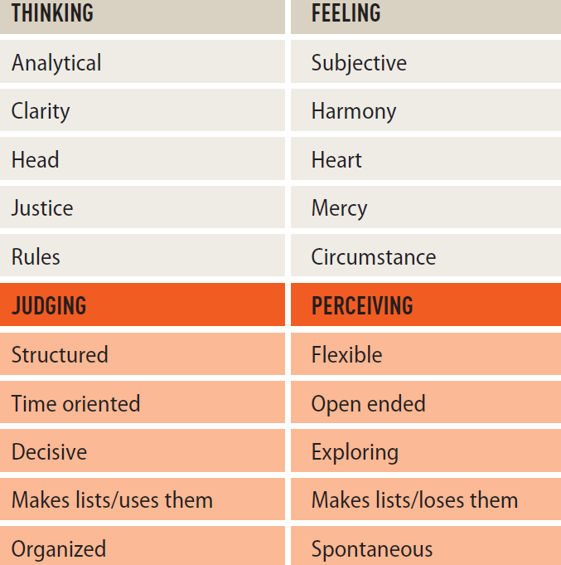
MBTI Preferences (2)
Decision making
Lifestyle

Slide 9
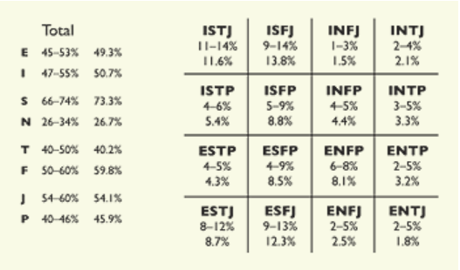
Personality types
statistics
Source: Meyers & Briggs Foundation

Slide 10
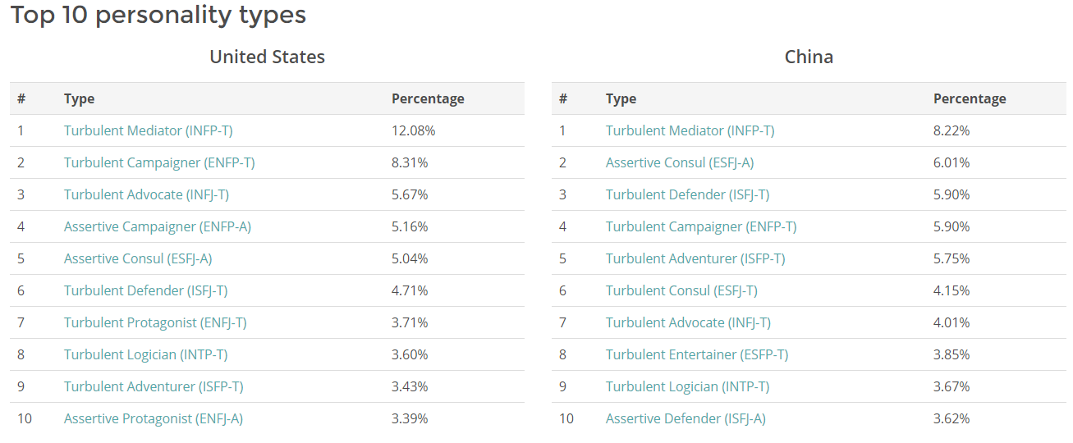
https://www.16personalities.com/country-profiles/

Slide 11
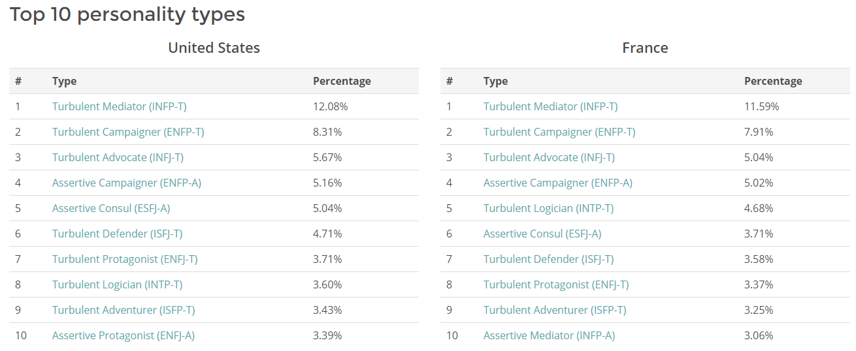

Slide 12
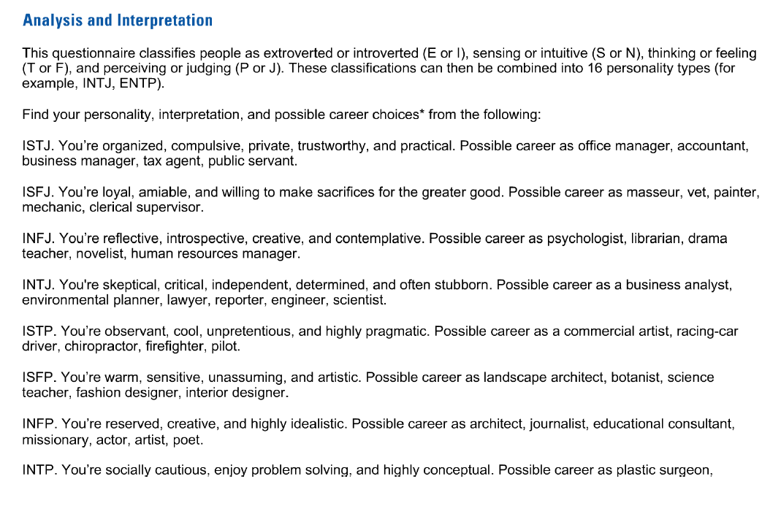
MBTI Types (1)

Slide 13
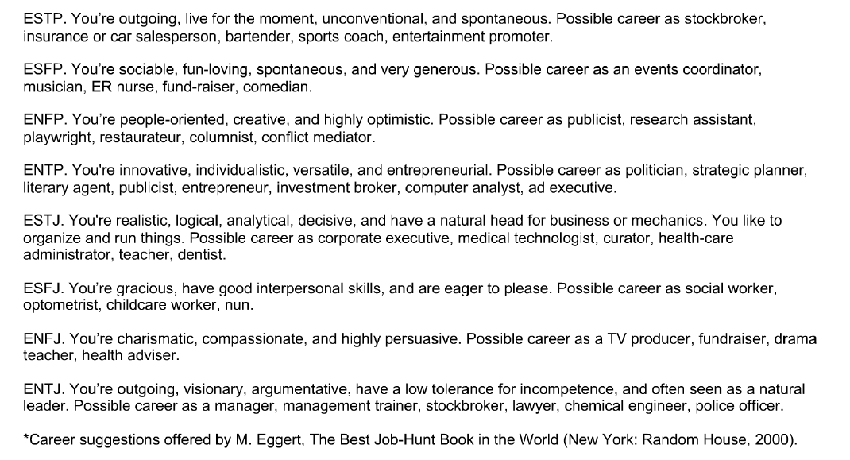
MBTI Types (2)

Slide 14
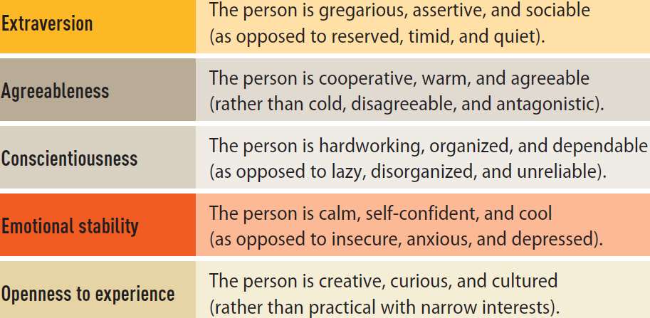
Trait Theory – Big 5
Comfort with relationship
Tendency to defer to others
Reliability
Supporting stress
Interest with the new and unknown

Slide 16
Personality and Individual characteristics: Team work
What did you learn about yourself in your test results?
Reflect on Peter Drucker’s “Managing Oneself” and find your Strengths, Learning Style and Values
Discuss your results (what you want to disclose is up to you) in your team: EI, LSI, Big5, MBTI, etc. and self-reflection
  What are your findings
  What consequences on relationships
  What will you need to be aware of/ to do heading toward the Team project
Summary report: 1-2 slides max/bullet points (count as writing assignment)
Report out by team, 3' each + Q&A

Slide 18
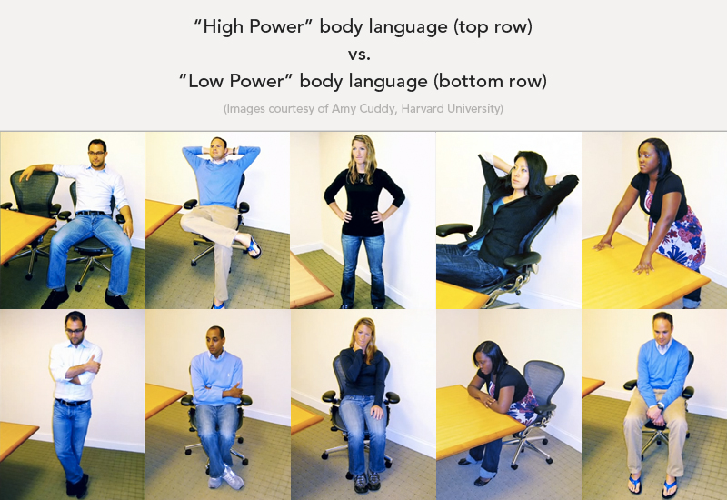

Slide 19
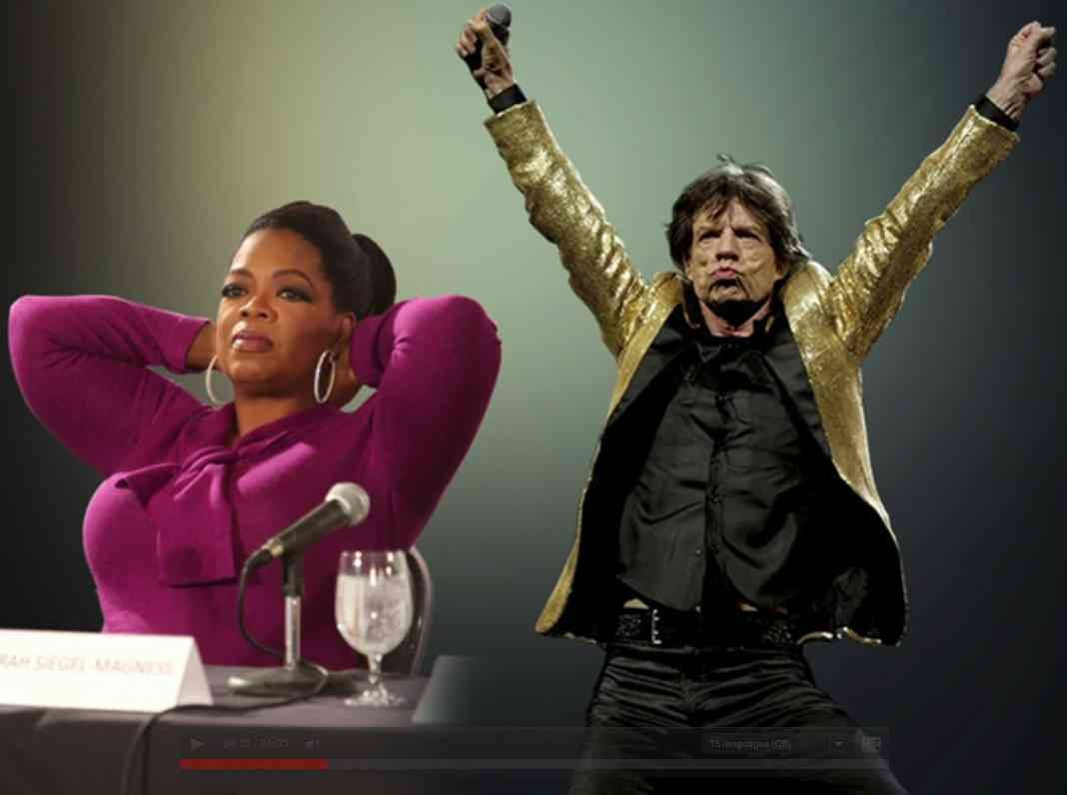

Slide 20
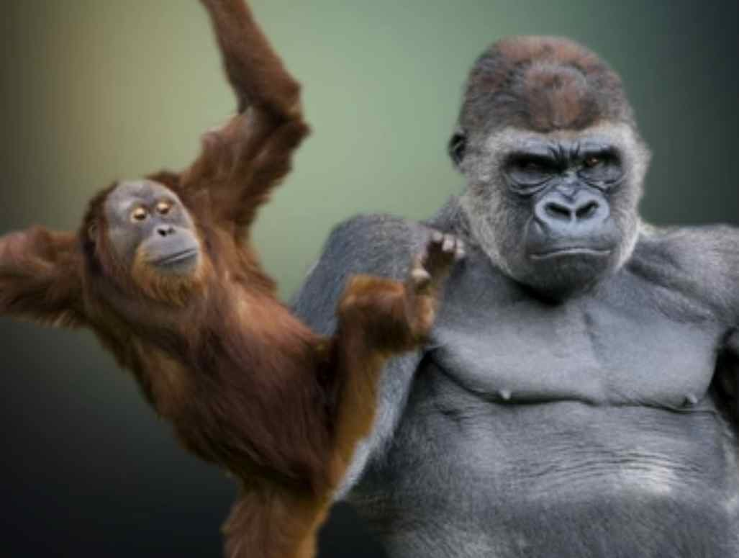

Slide 21
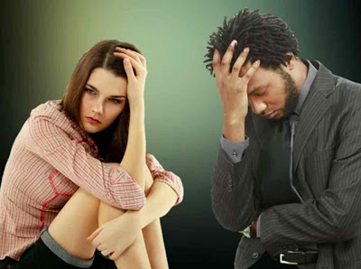

Slide 22
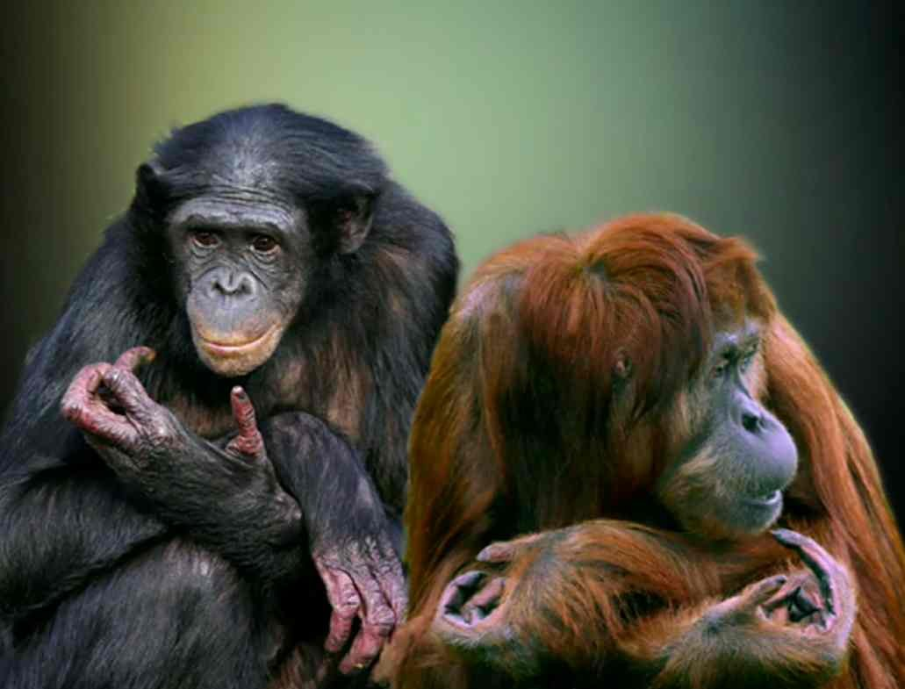

Slide 23
Perception and Reality
“Everything you see or hear or experience in any way at all is specific to you. You create a universe by perceiving it, so everything in the universe you perceive is specific to you.”
– Douglas Adams
“Reality is merely an illusion, albeit a very persistent one.”
– Albert Einstein

Slide 24
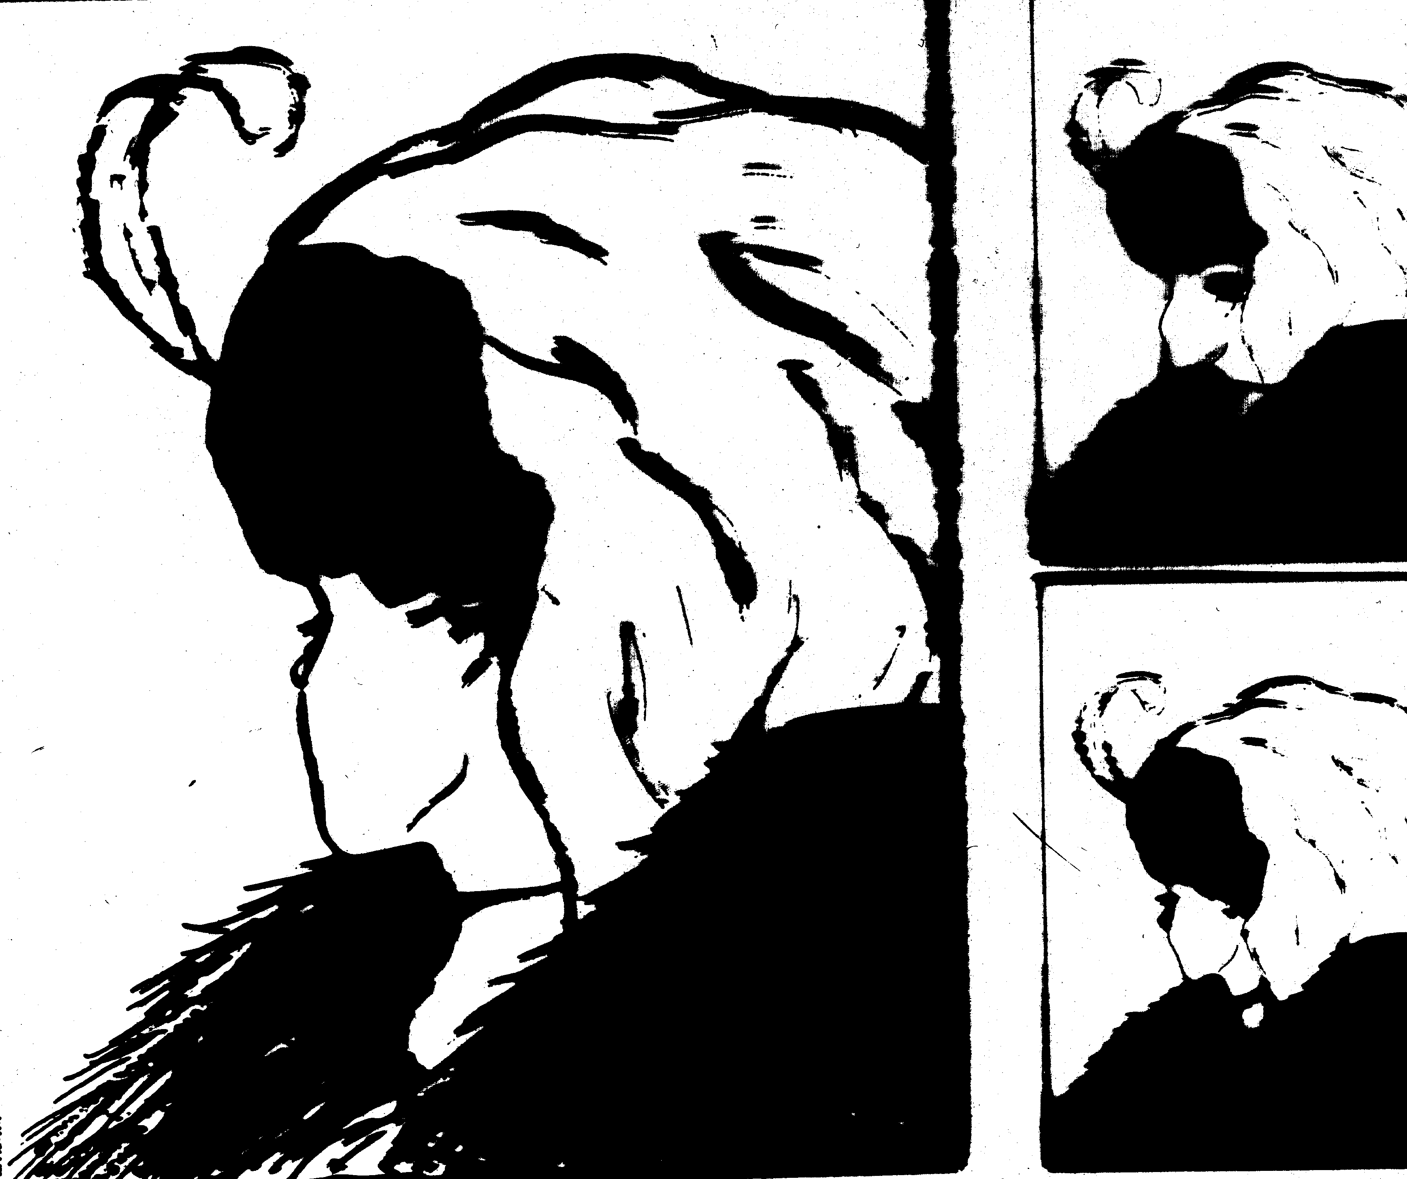
`
©2001 by Prentice Hall, Inc.

Slide 25

©2001 by Prentice Hall, Inc.

Slide 28
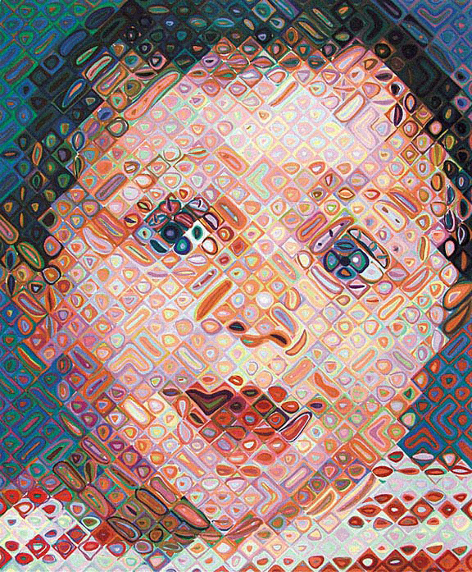

Slide 32
Emma, Chuck Close

Slide 33


Slide 38


Slide 39
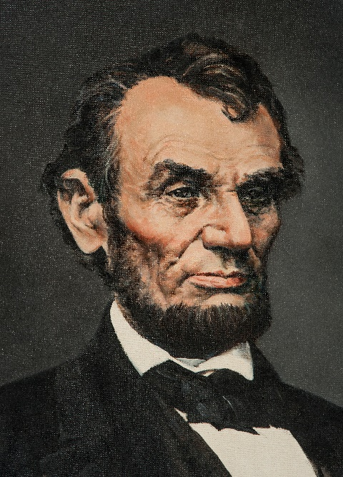

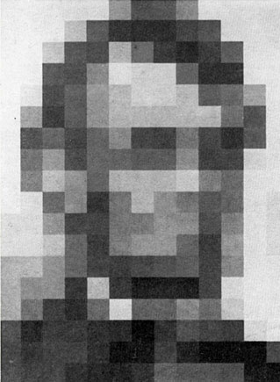
Abraham Lincoln, Bruce Stark
Lincoln, Leon Harmon
Gaia looking at the Mediterranean sea, Salvador Dali

Slide 40
Social Perception
Process of interpreting information about another person
Discounting principle: Assumption that an individual’s behavior is accounted for by the situation
While perception is not reality, it is everyone’s own reality.
Everything begins with a decision – decide now to be in charge of your own perception of reality. Because if you don’t, there are plenty of folks whose sole purpose in life is to craft that perception for you.
- Tony Clarke

Slide 41
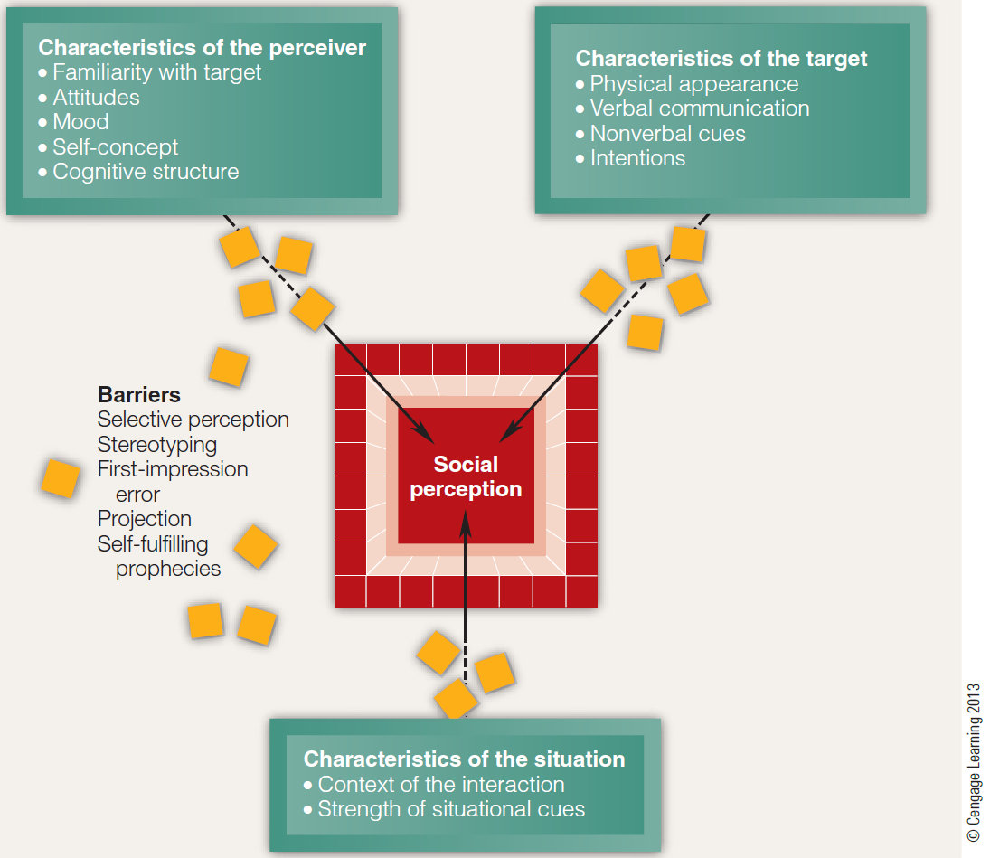
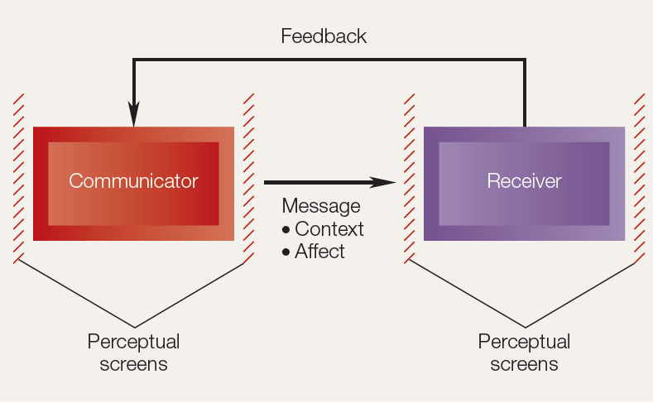
A model for social perception

Slide 42
Barriers to Social Perception
Selective perception
  Selecting information that supports our individual viewpoints while discounting information that threatens our viewpoints
Stereotype
  Generalization about a group of people
First-impression error
  Forming lasting opinions about an individual based on initial perceptions

Slide 43
Barriers to Social Perception
Projection
  Overestimating the number of people who share our own beliefs, values, and behaviors
Self-fulfilling prophecy
  Allowing expectations about people to affect our interaction with them in such a way that those expectations are fulfilled
Impression management
  Process by which individuals try to control the impressions others have of them

Slide 44
Attribution Theory
Explains how individuals pinpoint the causes of their own and others’ behavior
Internal source - Something within the individual’s control
External source - Something outside the individual’s control

Slide 45
Attribution Biases
Fundamental attribution error
  Tendency to make attributions to internal causes when focusing on someone else’s behavior
Self-serving bias
  Attributing one’s successes to internal causes and one’s failures to external causes

Slide 47
Social Perception: Team work
What is perception? How does it influence attitudes and behaviors?
Women on 1 side, Men on the other side
Each group works at gathering sentences about how they perceive the other group (opposite sex) in terms of emotions, perceptions, behaviors, attitudes, personality, etc.). Hide your work from the other group.
Group A picks one statement and present for class discussion and debate. Then Group B.
Second round of statements A and B
Class discussion on perception strengths, origin, formation.
One spokesperson of each group present together the conclusions and learnings.

Slide 48
Stereotypes: Team exercise
Reflect on situations in which you felt you were victims of a negative stereotype.
Consider whether you have ever benefited from a positive stereotype.
Think about whether you have unfairly viewed others based on a negative stereotype, or whether you have expected something because of a positive stereotype of another individual.
Present your findings to the class and discuss the implications of stereotyping, both negative and positive.

Slide 49
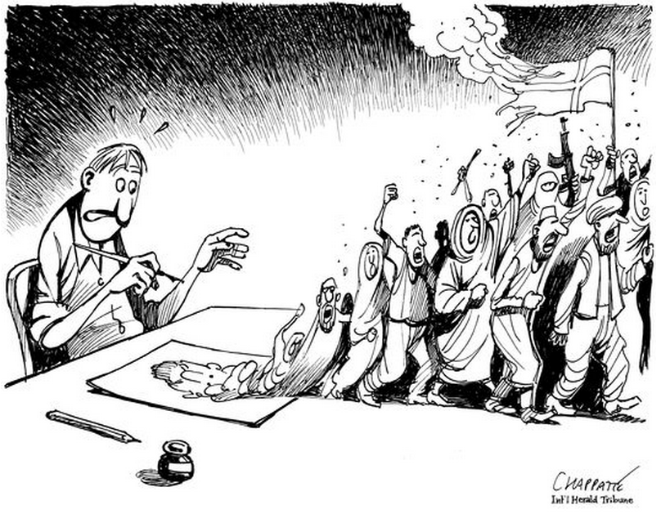
Globalization: Is humor global?

