Slide 1
Staffing Organizations
Chapter 5:
External Recruitment

Slide 2
Learning Objectives for Chapter 5
Engage in strategic recruitment planning activities
Understand the difference between open and targeted recruitment
Create a persuasive communication message
Learn about a variety of recruitment media
Recognize how applicant reactions influence the effectiveness of a recruiting plan
Utilize a variety of recruitment sources
Evaluate recruiting based on established metrics

Slide 3
External Recruitment
Strategic Recruitment Planning

Slide 4
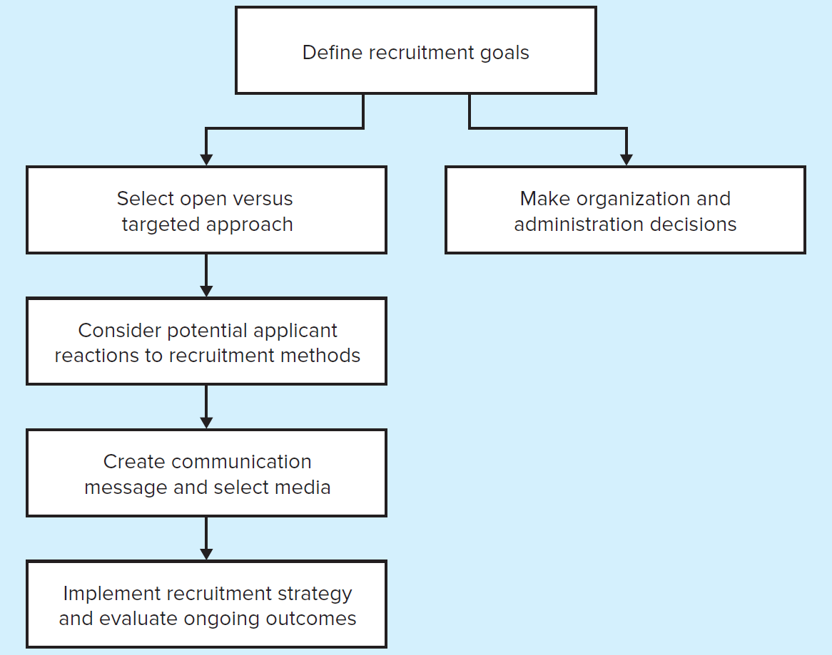
Planning, Communicating, and Implementing Strategic Recruiting
Jump to Planning, Communicating, and Implementing Strategic Recruiting, Appendix

Slide 5
Defining Strategic Recruiting Goals
Goals for attraction
Based on organization’s strategic goals
Person-job fit
Person-organization fit
Goals for speed
Need new employees right away
Long-term needs

Slide 6
Open Versus Targeted Recruiting
Recruitment Type | Technique | Advantages | Best When
Open | Advertising position with a message appealing to a wide variety of job seekers in a variety of media outlets that will reach the highest possible audience | Ensures that a diverse set of applicants are contacted and considered Lower resource and personnel cost per applicant located | Large numbers of applicants are required Pre-entry qualifications are not as important
Targeted | Focusing advertising and recruiting efforts by tailoring message content to attract segments of the labor market with specific KSAOs or demographic characteristics | Narrows the pool of potential applicants, allowing the organization to concentrate efforts on the most qualified Facilitates a more personal approach to each applicant | The organization needs specific skill sets that are in short supply Hiring for high-leverage positions

Slide 7
Recruitment Planning: Administrative Issues
In-house vs. external recruitment agency
Many companies do recruiting in-house
Recommended approach for large companies
Smaller companies may rely on external recruitment agencies
Individual vs. cooperative recruitment alliances
Cooperative alliances involve arrangements to share recruitment resources
Centralized vs. decentralized recruitment

Slide 8
Example Recruitment Budget
Should recruitment expenses be charged to HR or to the business unit using HR services?
Most organizations charge the HR department, possibly to encourage each business unit to use the recruitment services of the HR group
May result in the business unit users not being concerned about minimizing costs.

Slide 9
Example of a Recruitment Budget for 500 New Hires
Expenses | Amount in dollars
Administrative staff expenses | 32,000
Administrative supplies expenses | 45,000
Administrative equipment expenses | 10,000
Total administrative expenses | 87,000
Recruiter salaries expenses | 240,000
Recruiter benefits expenses | 96,000
Recruiter expenses | 150,000
Total recruiter expenses | 486,000
Candidate travel expenses | 320,000
Candidate lodging expenses | 295,000
Candidate fees expenses | 50,000
Candidate relocation expenses | 150,000
Total candidate expenses | 815,000
Total Recruitment expenses: The sum of 87,000, 486,000, and 815,000 | 1,388,000
Total Cost per Hire: 1,388,000 divided by 500 new hires | 2,776

Slide 10
Discussion Question
List and briefly describe each of the administrative issues that needs to be addressed in the planning stage of external recruiting.

Slide 11
External Recruitment
Applicant Reactions

Slide 12
Applicant Reactions
Job and organization characteristics
The most important attraction features
Job characteristics
Wages
Opportunity for growth and development
Interesting characteristics
Organization characteristics
Prestige
Reputation for treating employees well

Slide 13
Applicant Reactions
Reactions to recruiters
Influence of recruiter vs. job characteristics
Influence of recruiter on attitudes and behaviors
Demographics of recruiters
Influential recruiter behaviors
Warmth and knowledge of the job
Reactions to recruitment process
Relationship of screening devices to job
Delay times in recruitment process
Funding of recruitment process
Credibility of recruiter during recruitment process

Slide 14
Reactions to Diversity Issues
Advertising in publications targeted at women and minorities
Advertisements should depict diversity, especially among those in positions of authority
Target older workers by flexible schedules, health and pension benefits, and part-time opportunities

Slide 15
Consideration Related to Recruiters: Selection
Desirable characteristics of recruiters
Strong interpersonal skills
Knowledge about company, jobs, and career-related issues
Technology skills
Enthusiasm
Various sources of recruiters
HR professionals
Line managers
Employees

Slide 16
External Recruitment
Communication

Slide 17
Comparing Choice of Messages
Types of Messaging | Information Conveyed | Applicant Reactions | Potential Drawback | Best For
Branded | An appealing description is developed based on marketing principles, emphasizing unique features of the organization | Positive view of the organization, increased intention to apply for jobs, and better prehire information about benefits of the job | Overly positive message may result in employee dissatisfaction after hire | Tight labor markets or higher-value jobs
Targeted | Advertising themes are designed to a attract a specific set of employees | Better fit between application message and specific applicant groups | May dissuade applicants who aren’t interested in work attributes featured in the message from applying | Specific KSAOs, or seeking a specific type of applicant
Realistic | Both positive and negative aspects of a job and organization are described | Some applicants self-select out; those who remain will have a better understanding of the job and will be less likely to leave | The best potential applicants may be more likely to leave | Loose labor markets or when turnover is costly

Slide 18
Searching: Communication Media
Media richness
Allow for timely personal feedback
Provide ample information
Customized to user needs
Credibility
Honest
Accurate
Thorough

Slide 19
Communication Media
Arranged from lowest richness and credibility to highest richness and credibility
Advertisements
Recruitment brochures
Organizational websites
Videoconferencing
Direct contact
Richer, more credible sources tend to be the most expensive per applicant contacted

Slide 20
Features of High-Impact Organizational Websites
Easily navigated
A “job cart” function
Résumé builders
Detailed information on career opportunities
Clear graphics
Allow applicants to create profiles
Self-assessment inventories

Slide 21
Communication Media
Word-of-mouth
Personally known to the potential applicant
Largely outside of the organization’s control
Heavily involved with the reputation of the organization

Slide 22
Discussion Questions
In designing the communication message to be used in external recruiting, what kinds of information should be included?
What are the advantages of conveying a realistic recruitment message as opposed to portraying the job in a way that the organization thinks that job applicants want to hear?
What nontraditional inducements are some organizations offering so that they are seen as family-friendly organizations? What result does the organization hope to realize as a result of providing these inducements?

Slide 23
External Recruitment
Strategy Implementation

Slide 24
Strategy Implementation
Individual recruiting sources
Target individual job seekers, direct from the organization and its representatives
Applicant initiated, general employment websites, niche employment websites
Social recruiting sources
Rely on relationships that employees have with current employees or those who would endorse the company
Employee referrals, social networking sites, professional associations
Organizational recruiting sources
Access to a large number of similar applicants
Colleges and placement offices, employment agencies, executive search firms, social service agencies

Slide 25
Metrics for Evaluating Recruiting Methods
Quantity
Quality
Cost
Impact on HR Outcomes
Employee satisfaction
Job performance
Diversity
Retention

Slide 26
Discussion Questions
List 10 sources of applicants that organizations turn to when recruiting. For each source, identify needs specific to the source, as well as pros and cons of using the source for recruitment.

Slide 27
External Recruitment
Legal Issues

Slide 28
Legal Issues
Definition of job applicant
Definition according to EEOC and OFCCP
Importance of establishing written application policies
Affirmative Action Programs
Guidelines of OFCCP for recruitment actions
Electronic recruitment
Usage may create artificial barriers to employment opportunities
Job advertisements
Fraud and misrepresentation

Slide 29
Ethical Issues in Staffing
Issue 1
Many organizations adopt a targeted recruitment strategy. For example, Home Depot has targeted workers 50 and above in its recruitment efforts, which include advertising specifically in media outlets frequented by older individuals. Other organizations target recruitment messages at women, minorities, or those with desired skills. Do you think targeted recruitment systems are fair? Why or why not?
Issue 2
Most organizations have in place job boards on their web page where applicants can apply for jobs online. What ethical obligations, if any, do you think organizations have to individuals who apply for jobs online?

Slide 30
APPENDIX

Slide 31
Planning, Communicating, and Implementing Strategic Recruiting, Appendix
There is a rectangular box that reads define recruitment goals at the top. There are two arrows that branch out from this box and point to two boxes below it that read select open versus targeted approach and make organization and administration decisions. There are three boxes below the box select open versus targeted approach that are placed one below the other. Each box has an arrow that leads to the box below it. The three boxes read consider potential applicant reactions to recruitment methods, create communication message and select media, and implement recruitment strategy and evaluate ongoing outcomes.
Jump back to Planning, Communicating, and Implementing Strategic Recruiting

