Slide 2
Marketing Challenge Option 1
Digital Marketing Nanodegree Program

Slide 3
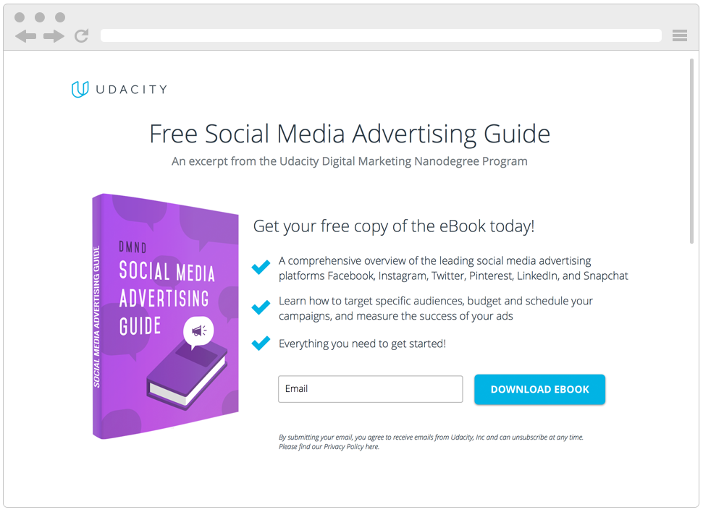
Digital Marketing Nanodegree Program
You are tasked with attracting future fellow students for this Digital Marketing Nanodegree Program. More specifically, your objective is to collect email addresses of potential students, who could be interested in taking this course. In order to do this, we have created a landing page, where prospective students can download a free eBook if they provide us with their email address. The eBook – a Social Media Advertising Guide – is a short excerpt from the Digital Marketing Nanodegree Program, content that you will see in the Social Advertising course. For the purpose of the projects, assume costs of $0 for the eBook and a conversion value (revenue) of $15 per collected email address.

Slide 4
Step 1:
Getting Started

Slide 5
The target Potential students for DMND Program
Which option did you choose? (Udacity
If Udacity, which product did you choose? (DMND Program)
If your own company, tell us about your product/service (insert a link to your landing page in your submission)

Slide 6
Marketing Objective: DMND
Provide the marketing objective for the product you chose?
For example: Betabrand might have a marketing objective to sell 1,000 pairs of women’s pants in May 2017.

Slide 7
KPI: DMND
What is your primary KPI to measure marketing success? For example: The KPI for Betabrand’s marketing objective would be the number of women’s pants sold in May.

Slide 8
Step 2:
Value Proposition

Slide 9
Value Proposition
Write a value proposition using Geoffrey Moore’s template for the product you chose: For (target customer) who (statement of the need or opportunity) our (product/service) is (product category) that (statement of benefit). Unlike (closest competitor), our offer (primary differentiation). For example, Ezequiel Farca’s value proposition might read: FOR design minded customers WHO need a home custom designed to their needs and taste OUR architecture and design services THAT offer high end modern design UNLIKE architecture firms like WRNS Studio OUR OFFER balances harmonious modern architecture, with our own award winning interior design & furniture If you need more inspiration, see more on value propositions on HubSpot.

Slide 10
Step 3:
Customer Persona

Slide 11
Interview
What questions did you ask your interviewees? If there isn’t enough space you can link to the questions and answers and simply put a few highlights here.
Suggested Questions

Slide 12
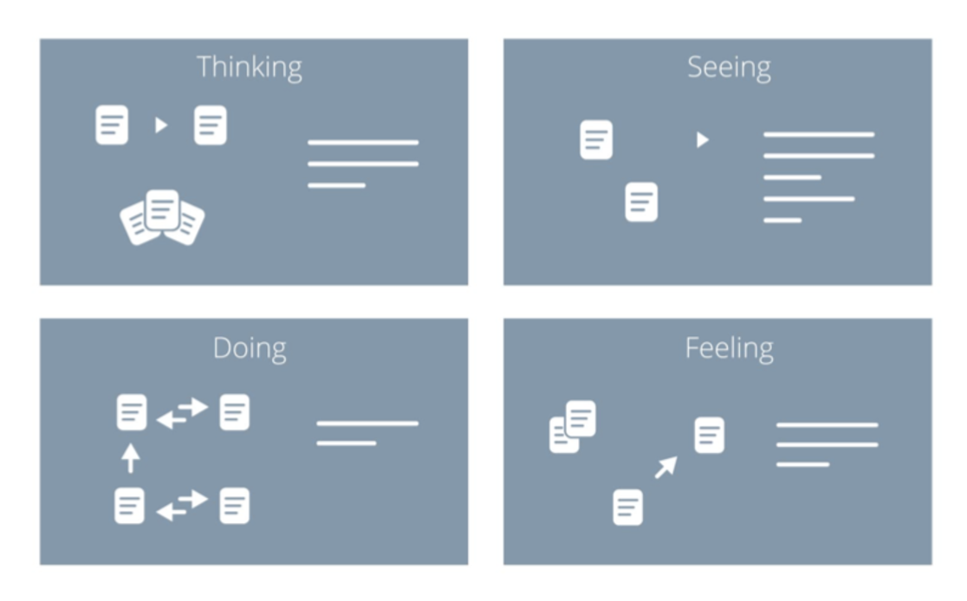
Empathy Map
Insert a picture or design the slide to show your empathy map. Keep in mind to provide your interviewees’ answers as much as possible, listed with the actual words and phrases your customers say, the applications they use, and the websites they visit.
Sample

Slide 13
Target Persona
Background and Demographics | Target Persona Name | Needs
Hobbies | Goals | Barriers

