Slide 1
Valuation and Financing of Healthcare Services and Information Technology Infrastructure
Information technology
Financing services
Health system
Slide 15.1
Copyright © 2019 Foundation of the American College of Healthcare Executives. Not for sale.

Slide 2
Four Basic Health Financing Models
Beveridge model—hospitals with salaried physicians owned and financed by the national government
Bismarck model—employees and their employers pay into a pool to finance healthcare services
National health insurance model—healthcare services financed by state and federal governments, purchased from local private or public health hospitals or clinics
Out-of-pocket model—people with no health insurance pay out of pocket
Slide 15.2
This file has not yet been edited.
Copyright © 2018 Foundation of the American College of Healthcare Executives.
Not for sale.

Slide 3
Health Services Financing: Out-of-Pocket
The exclusive method of paying for services in the US prior to the 1920s.
Families might pay with in-kind services but felt a deep moral responsibility for this financial obligation.
One exception was families without resources, taken care of as wards of the county (Poor House).
These values still remain strong in US culture.
Slide 15.3
Copyright © 2019 Foundation of the American College of Healthcare Executives. Not for sale.

Slide 4
Health Services Financing: Cost-Based Reimbursement
Developed in the mid-1920s
Costly surgical and medical procedures in hospitals
Blue Cross covered high-cost hospital care.
Fee-for-service financing through private insurance companies became the norm.
Slide 15.4
Copyright © 2019 Foundation of the American College of Healthcare Executives. Not for sale.

Slide 5
Health Services Financing: Capitation Financing
Capitation fee paid in advanced and based on:
Keeping the enrolled population healthy
Minimizing hospitalizations
Minimizing the use of specialty care
Why did physicians resist capitation-based insurance?
Why did physicians not lead in managing population health?
Slide 15.5
Copyright © 2019 Foundation of the American College of Healthcare Executives. Not for sale.

Slide 6
Health Services Financing: Value-Based Financing
Introduced in the 1980s under Medicare and Medicaid as diagnostic-related groups (DRGs), with payment based on diagnosis rather than fee-for-service.
Emerged as bundled payments provided in combination with fee-for-service; bundled payments transcend hospitals and include the entire care process by diagnosis.
Case-based reimbursement rewards the development of teams of health professionals.
Slide 15.6
Copyright © 2019 Foundation of the American College of Healthcare Executives. Not for sale.

Slide 7
Lack of Coordination and Information Sharing
Current financing systems reinforce fragmentation in the delivery of services through fragmented payment methods.
Under bundled payments, a number of related services are bundled into a single product at a set price, but the incentive is given for providing more of the bundled service
Health insurance has been developed piecemeal with an incremental focus without an understanding of the effect on health system costs, quality, or wellness.
Slide 15.7
Copyright © 2019 Foundation of the American College of Healthcare Executives. Not for sale.

Slide 8
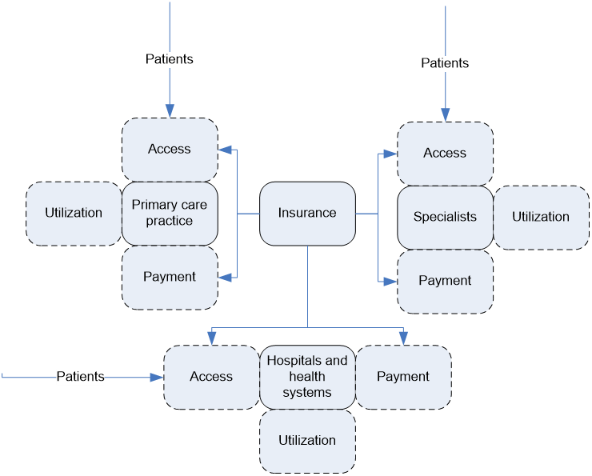
Configuration of Insurance-Centric, Fragmented Healthcare Delivery System
Slide 15.8
Copyright © 2019 Foundation of the American College of Healthcare Executives. Not for sale.

Slide 9
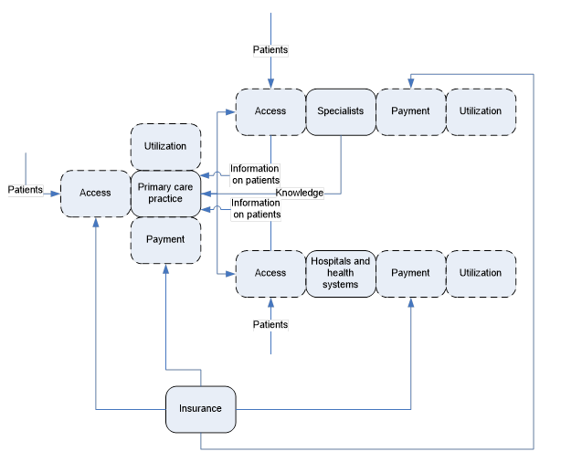
Information Sharing at the Core of a Coordinated System
Slide 15.9
Copyright © 2019 Foundation of the American College of Healthcare Executives. Not for sale.

Slide 10
Financing Medical Homes
Medical homes are not primarily a financing model but rather a delivery model with mixed financing.
They use combinations of financial models:
Bundled payments with pay-for-performance incentives
Capitation based on per-member-per-month
Dominant payment model is fee-for-service
Consultations provided outside the medical home “system” reimbursed on fee-for-service basis
If the organization is able to achieve target savings, they share the savings as an incentive.
Slide 15.10
Copyright © 2019 Foundation of the American College of Healthcare Executives. Not for sale.

Slide 11
Coordinating Care in Medical Homes
A “capitation supplemental fee” is paid for the coordination of care within the medical home and “managing” consultations.
The coordination of care using a team approach is fundamental to the design of medical homes.
The coordination fee is paid to augment the salaries of the primary care physicians within the medical home.
Slide 15.11
Copyright © 2019 Foundation of the American College of Healthcare Executives. Not for sale.

Slide 12
Medical Homes Align Many System Elements
Medical homes align within an episode of care information, organization design, clinical processes, and financing.
Utilization rates of emergency services, referrals to specialist, hospital beds, laboratory, and inpatient pharmacy are reduced.
They are relatively closed systems with multiple and conflicting payment mechanisms, some that inhibit the system from further improvement without additional system transformation.
Slide 15.12
Copyright © 2019 Foundation of the American College of Healthcare Executives. Not for sale.

Slide 13
Accountable Care Organization Financing Models
A voluntary group of stakeholders—physicians, other health professionals, hospitals, and health plans—forms to provide coordinated high-quality care for a population of patients.
Information exchange is a required and key element for shared consultations and coordinated services.
Payment for services is primarily on a fee-for-service basis with a financial incentive or gainshare if costs are reduced and quality improves.
Slide 15.13
Copyright © 2019 Foundation of the American College of Healthcare Executives. Not for sale.

Slide 14
Accountable Care Organization Performance
ACOs consistently improve performance over previous disaggregated institutions and information systems by reducing cost and improving quality and continuity.
The effectiveness of ACOs in addressing and improving population health has been limited due in part to current financing models.
Among the significant factors related to performance within ACOs, there is more focus on structure than on financing.
Slide 15.14
Copyright © 2019 Foundation of the American College of Healthcare Executives. Not for sale.

Slide 15
Investing in Health IT
Healthcare is provided in US by a combination of the public, private nonprofit, and for-profit sectors.
Each sector brings different assumptions about value. The valuation process is complex and investment lacks a rational strategy.
Slide 15.15
Copyright © 2019 Foundation of the American College of Healthcare Executives. Not for sale.

Slide 16
What Is IT Architecture? It Is More than IT
A tool for aligning IT and business strategy.
What IT capabilities enable strategy in healthcare? IT not only supports strategy, it becomes part of it—maybe as a dominant force.
Objectives of the IT architecture specify what the architecture enables the business to do.
Do organizations have a clear business strategy or just goal statements?
IT shapes business strategy, while business strategy shapes IT in response to changing market conditions and organizational realities.
Organizations must develop an IT architecture competency.
(Wells & Gobeli)
Slide 15.16
Copyright © 2019 Foundation of the American College of Healthcare Executives. Not for sale.

Slide 17
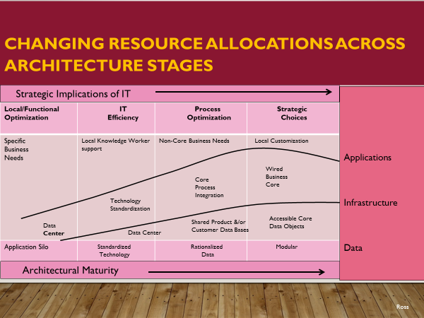
Slide 15.17
Slide 15.14
Copyright © 2019 Foundation of the American College of Healthcare Executives. Not for sale.

Slide 18
Modular Architecture
Enterprise-wide global standards
Loosely coupled applications
Preserve global standards while enabling local differences
Slide 15.18
Copyright © 2019 Foundation of the American College of Healthcare Executives. Not for sale.

Slide 19
Types of Health IT Architecture
Centralized architecture
Semidistributed architecture
Distributed architecture
Transinstitutional health information architecture
(Fragidis and Chatzoglou 2017)
Slide 15.19
Copyright © 2019 Foundation of the American College of Healthcare Executives. Not for sale.

Slide 20
To what level is IT tailored?
Department/
clinician
Hospital
ACO
Nation/world
All—it’s a system!
Slide 15.20
Copyright © 2019 Foundation of the American College of Healthcare Executives. Not for sale.

Slide 21
Information Technology Architecture
Health information architecture is considered a strategic
resource and the basis for system design.
It was designed initially in the US around individual clinical decision making (silo architecture) but is gradually evolving into system architecture.
In most countries, IT architecture was based on assumptions of a national or regional health system.
Slide 15.21
Copyright © 2019 Foundation of the American College of Healthcare Executives. Not for sale.

