Slide 1
Chapter 1, Part 2
Defamation and Obscenity

Slide 2
Defamation
Definition
Difference between Libel and Slander
Common Law v Constitutional Law
New York Times Co. v. Sullivan (1964) - why is it important
Public figures vs private figures

Slide 3
Defamation
Limit on Free Speech
First Amendment does not protect defamatory statements. No right to make a defamatory statement.
A person’s reputation is important.

Slide 4
So What is Defamation?
Tort
Remember the difference between a tort and a crime?
It’s all about who gets to bring the action in court and the standard under which you need to prove your case
False statement about a person that is communicated to another and injures a the person’s reputation.

Slide 5
Elements (parts) of Defamation Either 4 or 5 elements
1. False Statement -defamatory language
2. Concerning the Plaintiff (what is a plaintiff?)
3. Publication to a 3rd Party
4. Damage to Plaintiff’s Reputation
5. Public figure or newsworthy event then defendant must have made the false statement intentionally or with reckless disregard of the truth.
Public Figures/officials need to prove their was “actual malice” by person who spoke or published false info.

Slide 6
1. Defamatory Language
Anything that harms a person’ reputation.
Name calling isn’t enough. So calling someone a “jerk” isn’t defamatory.

Slide 7
2. Concerning the Plaintiff’s Reputation
Defamatory statement must be about the Plaintiff. A person can’t allege defamation if the statement is made about a relative.
Example: not good enough if the defamatory statement is about Emma Stones’ brother. She can’t sue.

Slide 8
3. Publication
Any communication to a third party
Note: pay attention to how the communication is made Libel v Slander (See damages)
Can’t defame someone by speaking directly to them.

Slide 9
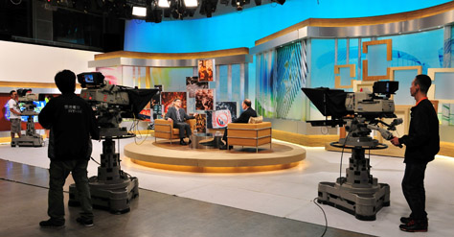
4. Damages: Difference between libel and slander makes a difference for the damages (harm) I need to prove
Libel
Slander
Libel is written or permanent defamatory statement
Broadcasting is permanent
No monetary damages need to be suffered (no “Special Damages”)
Slander is Spoken
Need monetary harm “Special Damages”
See 4 exceptions to having to have suffered $ harm.
Gossip v Slander

Slide 10
Slander (spoken)-–must prove Special Damages (suffer $ loss) unless:
These four areas are called Slander Per Se
Adverse impact of business
Loathsome disease (no cure, highly communicable)
Guilty of crime (crime of moral turpitude, murder, theft…
Unchaste (indecent) behavior for a women. (Slut shaming vs a being a stud). Case law is slowing changing as societies view on sexuality changes- double edge sword?

Slide 11
Elements (parts) of Defamation
1. Defamatory Language
2. Concerning the Plaintiff (what is a plaintiff?)
3. Publication to a 3rd Party
4. Damage to Plaintiff’s Reputation
5. Fault/Intention Public Figures/public official

Slide 12
For Matters of Public Concern: How to Prove Fault. IF…………………
Plaintiff is a Public Figure/Official
Must Prove “actual malice”
From NY Times v Sullivan
Questions:
So who is a public figure?
Can you be a public figure for a
Limited purpose?
If Plaintiff is a Private Individal:
Only that defendant was negligent-didn’t exercise care that ORP would have in similar situation;
Can demonstrate actual malice but not necessary

Slide 13
NY Times v Sullivan
QUICK FACTS:
L.B. Sullivan was one of three people in charge of police in Montgomery. He sued the New York Times for libel (printing something they knew was false and would cause harm). The ad did not mention Sullivan’s name. But Sullivan claimed that the ad implied his responsibility for the actions of the police. He said that the ad damaged his reputation in the community.
Times appealed the decision to the United States Supreme Court. The newspaper had no reason to believe that the advertisement included false statements, so it did not check their accuracy. The Times argued that if a newspaper had to check the accuracy of every criticism of every public official, a free press would be severely limited
The Court reasoned that free and open debate about the conduct of public officials was more important than occasional, honest factual errors that might hurt or damage officials’ reputations.

Slide 14
NY Times v Sullivan
“First Amendment protects the publication of all statements, even false ones, about the conduct of public officials except when statements are made with actual malice (with knowledge that they are false or in reckless disregard of their truth or falsity).”
Fun fact: Sullivan sued the NY Times because it was the publisher- it wasn’t their content. Today, if NYT published someone else’s content online, they are protected under DCMA safe harbor provision but not print version.

Slide 15
Actual Malice
Defined: Public Figures/Officials
A statement made with knowledge that it was false; OR
A statement made with reckless disregard for whether it was false or not.

Slide 16
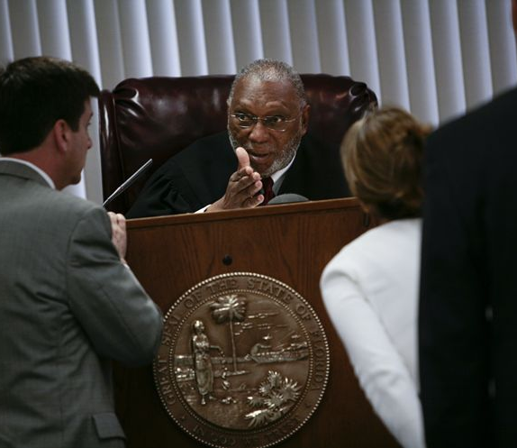
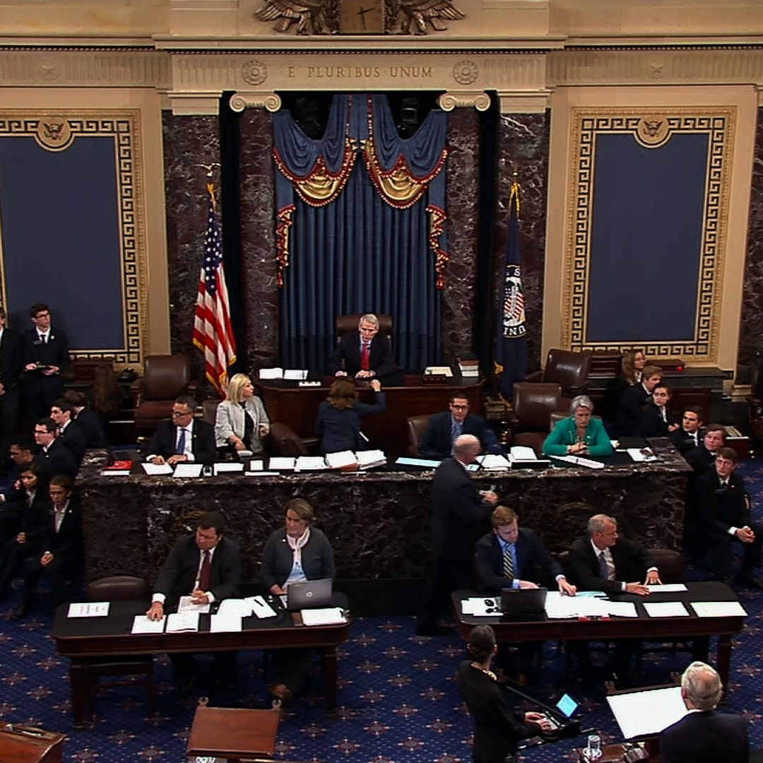
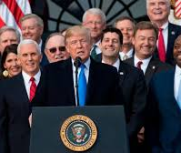
Five (5) Defenses to Charge of Defamation
Consent
Truth
Absolute Privilege: executive, legislature, judge/lawyer
Qualified Privilege-immunity from lawsuit for acts committed in the performance of a legal or moral duty. (witness at trial, statement to police)
Opinion Defense-not capable of being proven true or false.

Slide 17
Justice Thomas says that actual malice not rooted in Const.
https://www.nytimes.com/2019/02/19/us/politics/clarence-thomas-first-amendment-libel.html
Justice Thomas’s statement came in the wake of complaints from President Trump that libel laws make it too hard for public officials to win libel suits.
Sullivan suit was one of many suits filed by Southern politicians eager to starve the civil rights movement of the oxygen of national attention. They used libel suits as a way to discourage coverage of the movement by national news organizations.

Slide 18
Obscenity
Obscene material is not protected as free speech under 1st Amendment
Definition: Must meet three (3) criteria to be obscene
If work is obscene it is NOT protected by 1st Amendment and can be regulated and/or punished.

Slide 19
3 Steps to Obscene
Step 1: The average person, applying contemporary community standards, would find the work, taken as a whole, appeals the prurient interest in sex; and
1
Step 2: The work depicts or describes, in a patently offensive way, sexual conduct specifically defined by state or federal law; and
2
Step 3: The work, taken as a whole, lacks serious literary, artistic, political or scientific value.
3

