Slide 1
Definitions – 1
Theory
  “A set of interrelated concepts, definitions, and propositions that presents a systematic view of events or situations by specifying relations among variables in order to explain and predict the events of the situations” (Glanz, Lewis, & Viswanath, 2008, p. 26).
  For health education specialists, theories “provide a framework for generating testable hypotheses and integrating empirical evidence and, over time, a road map for the design and implementation of intervention strategies” (Rothman, 2009, p. 150S).

Slide 2
Definitions – 2
Model
  “A composite, a mixture of ideas or concepts taken from any number of theories and used together” (Hayden, 2009, p. 1)
    Do not have to explain, only represent process
    Can have several theories within a model
Concept
  Primary elements of theories or building blocks of theory (Glanz et al., 2008b)
Construct
  A concept developed, created, or adopted for use with a specific theory (Kerlinger, 1986)
Variable
  The operational (practical use) form of a construct (Rimer & Glanz, 2005); how a construct will be measured (Glanz et al., 2008b)
  Can be measured

Slide 3
Examples of the Definitions
Concept – Personal belief
Construct – Perceived barrier
Variable – On a scale of 1 to 10, with 1 being least important and 10 being most important, how important is wearing a safety belt to you?
Model – Health Belief Model
Theory – Social Cognitive Theory

Slide 4
Theories – 1
Theories serve as the backbone of processes used to plan, implement, and evaluate health promotion interventions.
There is no perfect theory, and no one theory dominates research or practice.
Approximately 10 theories and models are used regularly to plan programs.

Slide 5
Theories – 2
Theories can help by:
  Identifying why people are not behaving in healthy ways
  Identifying information needed before developing an intervention
  Providing a framework for selecting constructs to develop the intervention
  Providing direction and justification for program activities
  Providing insights into how best to deliver the intervention
  Identifying what needs to be measured to evaluate the impact of the intervention
  Helping to guide research identifying the determinants of health behavior

Slide 6
Types of Theories & Models
Planning models (or theories/models of implementation): theories and models used for planning, implementing, and evaluating health promotion programs
Behavior change theories (or change process theory)
  “Specify the relationships among casual processes operating both within and across levels of analysis” (McLeroy et al., 1992, p. 3)
  Help explain how change takes place

Slide 7
Behavior Change Theories – 1
The underlying concept of the socio-ecological approach (sometimes referred to as the ecological perspective) is that behavior has multiple levels of influences.
Social context
  “Defined as the sociocultural forces that shape people’s day-to-day experiences and that directly and indirectly affect health and behavior” (Burke, Joseph, Pasick, & Barker, 2009, p. 56S).
Because of the underlying concepts that are captured in the constructs of individual theories, certain theories are more useful in developing programs aimed at specific levels of influence.

Slide 8
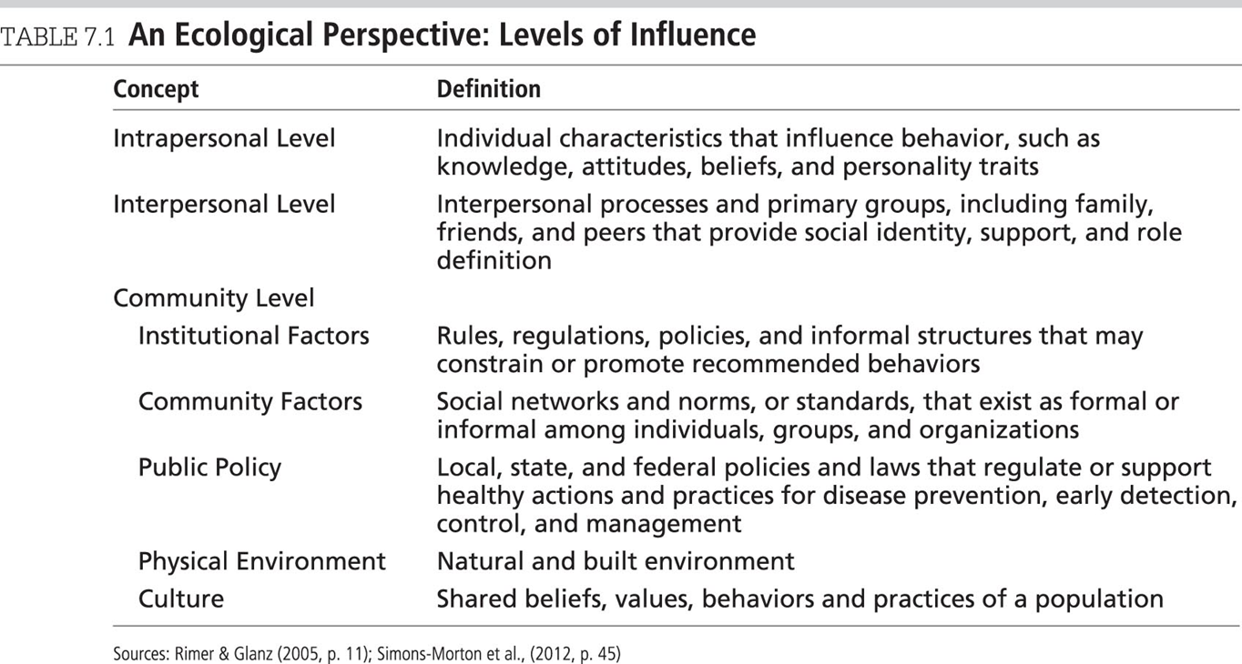
An Ecological Perspective: Levels of Prevention

Slide 9
Behavior Change Theories – 2
Theories can be categorized by approach:
Continuum Theories
  Use an approach that identifies variables that influence action and combines them into a prediction equation (e.g., HBM, TPB)
Stage Theories
  Are composed of an ordered set of categories into which people can be classified and that identify factors that could induce movement from one category to the next (e.g., TTM, PAPM, HAPA)

Slide 10
Behavior Change Theories – Intrapersonal Level
This group of theories focuses on factors within the individual such as knowledge, attitudes, beliefs, self-concept, feelings, past experiences, motivation, skills, and behaviors (Rimer & Glanz, 2005).
Examples
  Stimulus Response (SR)
  Theory of Planned Behavior (TPB)
  Health Belief Model (HBM)
  Protection Motivation Theory (PMT)
  The Elaboration Likelihood Model of Persuasion
  Information-Motivation-Behavioral (IBM) Skills Model
  Transtheoretical Model (TTM)
  Precaution Adoption Process Model

Slide 11
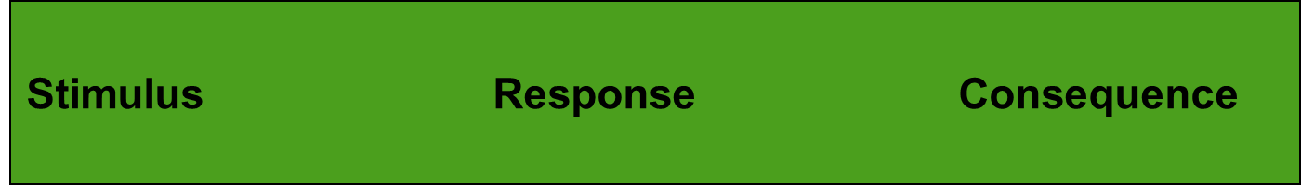


Stimulus Response (SR) Theory
The mere temporal association between a behavior and an immediately following reward is sufficient to increase the probability that the behavior will be repeated.
If the consequence is reinforcement then there is an increase in behavior.
If the consequence is punishment then there is a decrease in behavior.
Reinforcement should be frequent and occur soon after the desired behavior.
Complex behavior should be shaped in small steps.
Reinforcement and punishment can be either positive or negative.

Slide 12
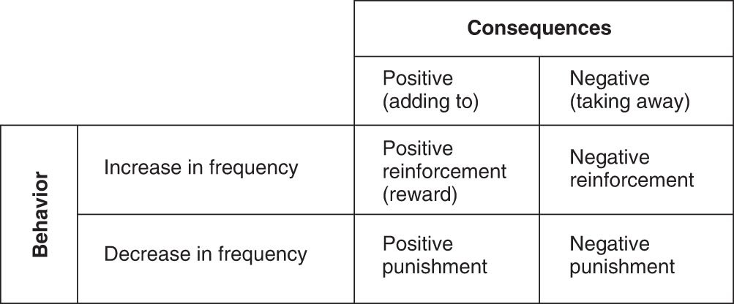
2 × 2 Table of the Stimulus Response Theory

Slide 13
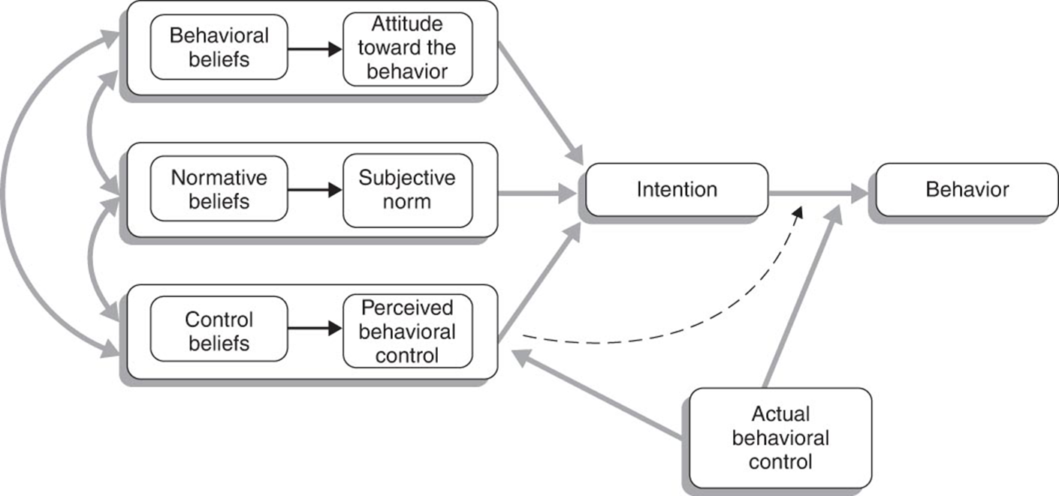
Theory of Planned Behavior (TPB) – 1

Slide 14
Theory of Planned Behavior (TPB) – 2
An extension of the theory of reasoned action (TRA); it addresses the problem of incomplete volitional control
Adds the concept of perceived behavioral control
  Perceived behavioral control – perceptions of a person's ability to perform a given behavior
  The more favorable the attitude and subjective norm with respect to a behavior, and the greater the perceived behavioral control, the stronger should be the individual's intentions to perform the behavior under consideration (Ajzen, 1988).
Successful performance of the behavior depends not only on a favorable intention but also on a sufficient level of behavioral control.

Slide 15
Health Belief Model (HBM) – 1
History
  Developed in 1950s by Hockbaum/Kegeles/Leventhal/Rosenstock to help explain the use of health services
  Based on K. Lewin’s decision-making model (goal oriented/directed)
Hypothesizes that health-related action depends on the simultaneous occurrence of three classes of factors:
  The existence of sufficient motivation to make issues salient or relevant
  The belief one is susceptible (or perceived threat)
  The belief that the benefits are worth the cost (or perceived barriers)

Slide 16
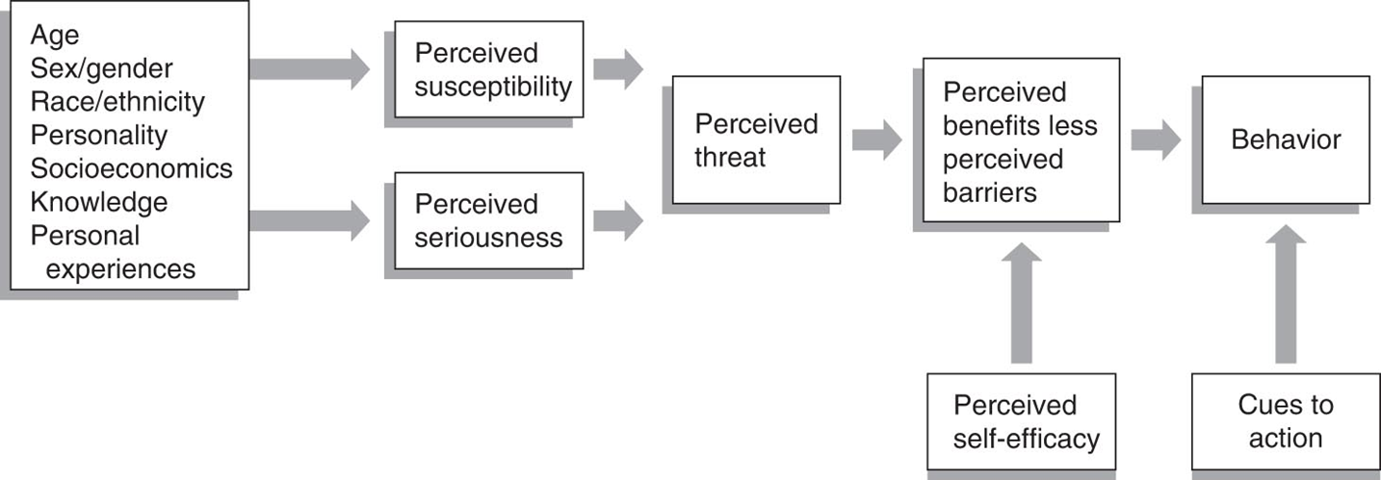
Health Belief Model

Slide 17
Health Belief Model (HBM) – 2
People must also feel themselves competent (self-efficacious) to overcome perceived barriers to taking action (Champion & Skinner, 2008, p. 50).
Constructs:
  Cues to action
  Perceived susceptibility
  Perceived seriousness/severity
  Perceived barriers
  Perceived benefits
  Likelihood of taking recommended preventive health action

Slide 18
Protection Motivation Theory (PMT) – 1
A value-expectancy theory
Theory of persuasive communication that includes reward and self-efficacy components
  The PMT has some similarities to the HBM.

Slide 19
Protection Motivation Theory (PMT) – 2
Inputs come from environmental sources of information and from intrapersonal sources.
  Based on these inputs, people make a cognitive assessment of whether there is a threat to their health.
  Arouses two cognitive mediating processes: threat appraisal and coping appraisal
Examples of program interventions that use PMT include breast self-examination, living wills, sun protection behavior, and weight loss.

Slide 20
The Elaboration Likelihood Model of Persuasion (ELM) – 1
Designed to help explain how persuasion messages (aimed at changing attitudes) were received and processed by people
  Has been used to help interpret and predict the impact of health messages
Useful in message tailoring

Slide 21
The Elaboration Likelihood Model of Persuasion (ELM) – 2
The ELM does four things:
  Proposes that modifying attitudes or other judgments can be formed as a result of a high degree of thought (i.e., central process route) or a low degree of thought (i.e., peripheral and processing route); postulates that there are numerous specific processes of change that operate along the elaboration continuum
  When comparing the consequences of the two routes, there are times when the results are similar. However, the two routes usually lead to attitudes with different consequences (Petty et al., 2009, p. 197).
  “Organizes the many specific processes by which variables can affect attitudes into a finite set that operate at different points along the elaboration continuum” (Petty & Briñol, 2012, p. 226)

Slide 22
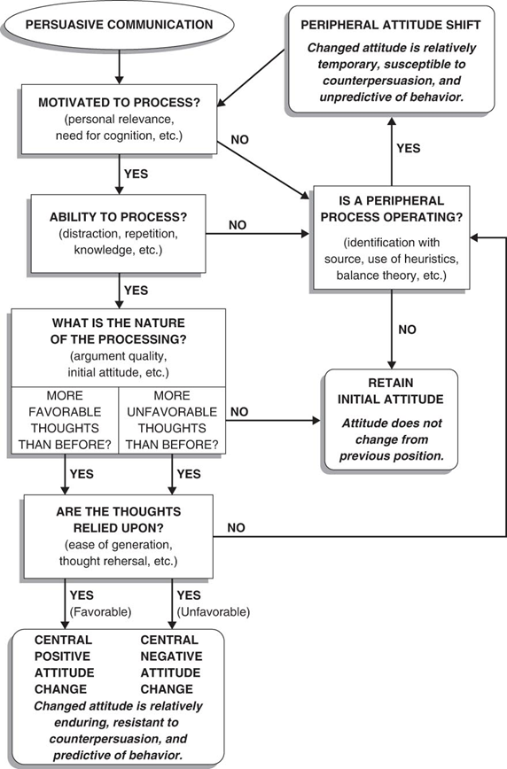
The Elaboration Likelihood Model of Persuasion (ELM) – 3

